Slide 1
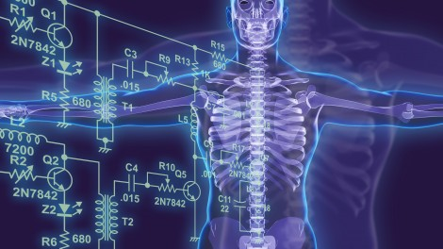
Dartmouth Science Scholars
December 6, 2023
Allan.J.Bieber@Dartmouth.edu
The Physician-Scientist career
Funding over the career timeline
K Award (Career development award) funding

Slide 2
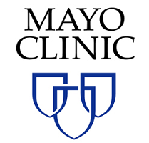
Allan Bieber
Career Path
B.Sci. Biology, 1978-1981
Research Area: Transcriptional regulation
Ph.D. Cell & Developmental
Biology, 1981-1986
Research Area: Transcriptional
regulation
“The Patient
Comes First”
GrantGPS, 2019
Assoc. Prof. of Neurosurgery and Neurology, 1997-2018 Director, Neuroscience Graduate Program
Research Areas: Neuro-immunology, MS
Neural engineering, DBS
Grant review: NIH, CDMRP (DoD), NMSS
Post-docs Developmental
Neuroscience,
1986-1990
Research Area: Neural development
Asst. Prof. of Biological Sciences, 1990-1997
Research Area: Neural development

Slide 3
Dartmouth GrantGPS
Who we are & What we do
We support faculty, postdoctoral fellows, and graduate students during every aspect of their pursuit of funding and intellectual impact. We can help you with:
One-on-one consultation
We meet at your convenience to discuss your research needs and to develop prospect lists, timelines, and proposals for books and grants.
Grant-writing training
We organize workshops that provide training on specific grant mechanisms, including NIH and NSF research proposals.
Grant editing and outside review
We work with you to draft and submit proposals and help to cover costs for professional copy-editing, scientific editing, and outside review of grant and fellowship proposals.
Allan.J.Bieber@dartmouth.edu
Angelika.H.Hofmann@dartmouth.edu Charlotte.M.Bacon@dartmouth.edu
Damiano.Benvegnu@dartmouth.edu
www.dartmouth.edu/gps/
GrantGPS@dartmouth.edu

Slide 4
What is a Physician-Scientist?
Professional Training: MD, DO, DDS/DMD, DVM/VMD,
DNP, PharmD
Research Training: PhD, Post-doc, K award, (R01)

Slide 5
Career Pathways of the
Physician Scientist
PhD Program
Medical School
MD MD/PhD
Training, Publications,
Recommendations
Medical School
MD/PhD
Program
R01
Biotechnology &
Pharmaceutical
Companies
Post-doctoral Training??
Publications, Training,
Recommendations,
Grants (F32, K99/R00)
Residency, Fellowship,
Clinical Practice,
Research Faculty
Clinical Practice, Publications,
Teaching, Administration,
Grants (K08, K23)
Residency, Fellowship,
Clinical Practice,
Research Faculty
Clinical Practice, Publications,
Teaching, Administration,
Grants (R01, R21)

Slide 6
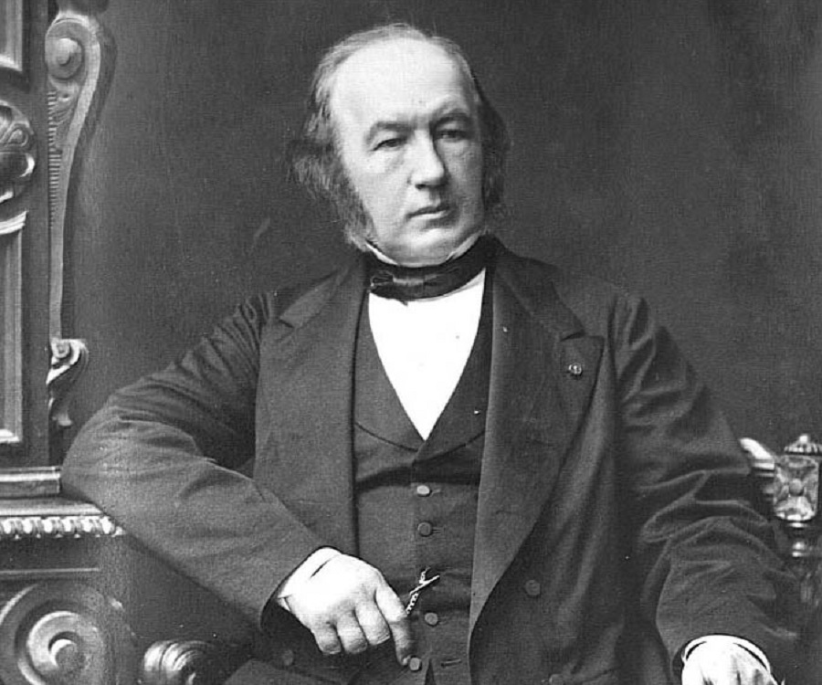
Why bother with a medical research career?
In a word, I consider hospitals only as the entrance to scientific medicine; they are the first field of observation which a physician enters; but the true sanctuary of medical science is a laboratory; only there can he seek explanations of life in the normal and pathological states by means of experimental analysis.
Claude Bernard, 1865
From: An Introduction to the Study of Experimental Medicine (Dover edition 1957; originally published in 1865; first English translation by Henry Copley Greene, published by Macmillan & Co., Ltd., 1927)
Doing research will make you a better doctor.
Being a doctor will make you a better researcher.
Personal benefits.

Slide 7
Challenges to the Physician Scientist Career
Personal (Money, time, mental and emotional bandwidth)
Residency (Research time)
Institutional challenges (Research time)

Slide 8
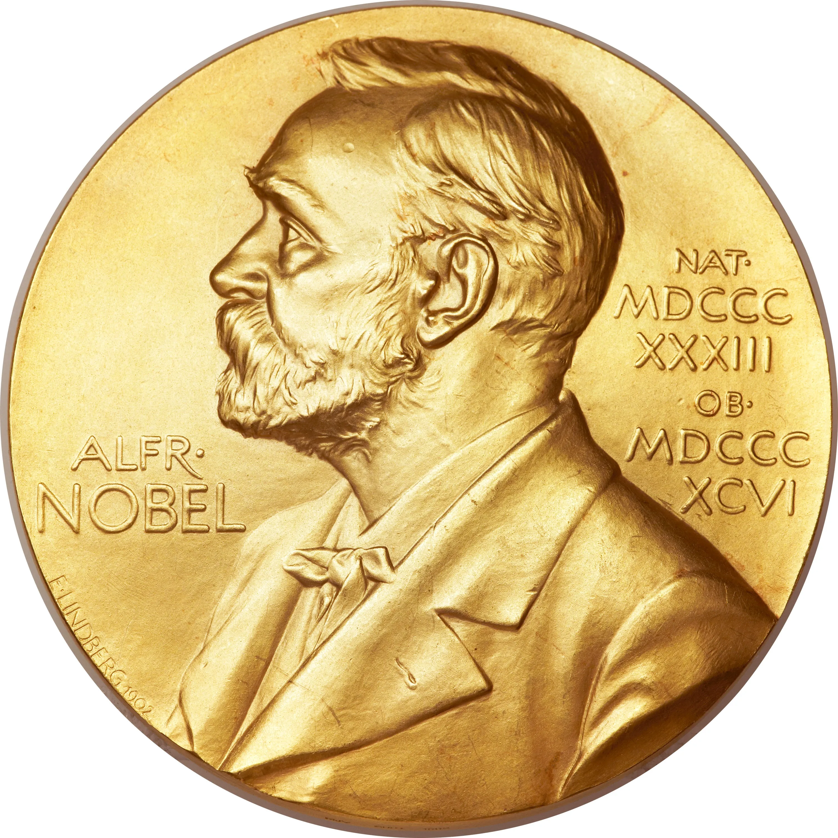
The Importance of Physician-Scientists:
Over the last 25 years, 37 percent of Nobel Laureates in Physiology or Medicine had an MD degree.
Over the last 30 years of Lasker Awards, 41 percent of the Basic Awards and 65 percent of the Clinical Awards have gone to MDs.
69 percent of NIH Institute Directors have an MD degree.
60 percent of the National Academy of Sciences Class IV (Biomedical Sciences) members have an MD degree.
70 percent of the chief scientific officers at the top pharmaceutical companies have an MD degree.

Slide 9
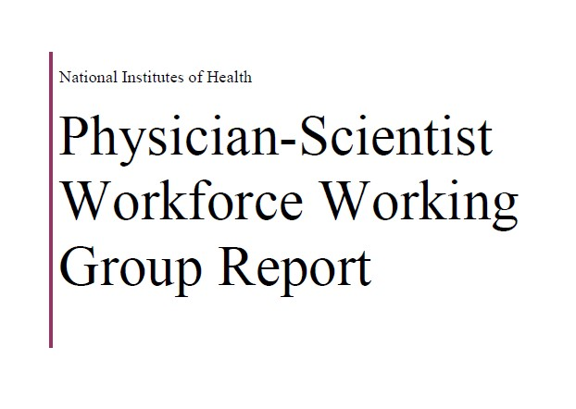
June 2014
https://acd.od.nih.gov/documents/reports/PSW_Report_ACD_06042014.pdf

Slide 10
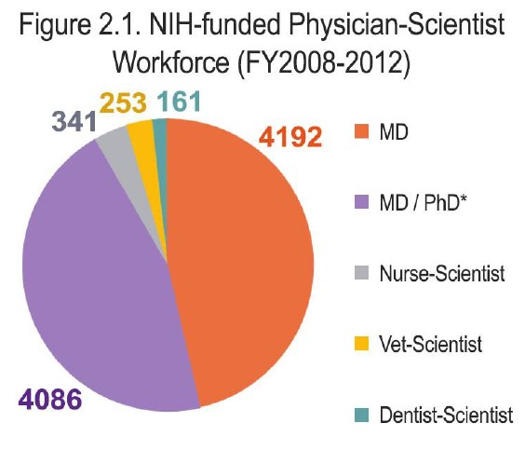
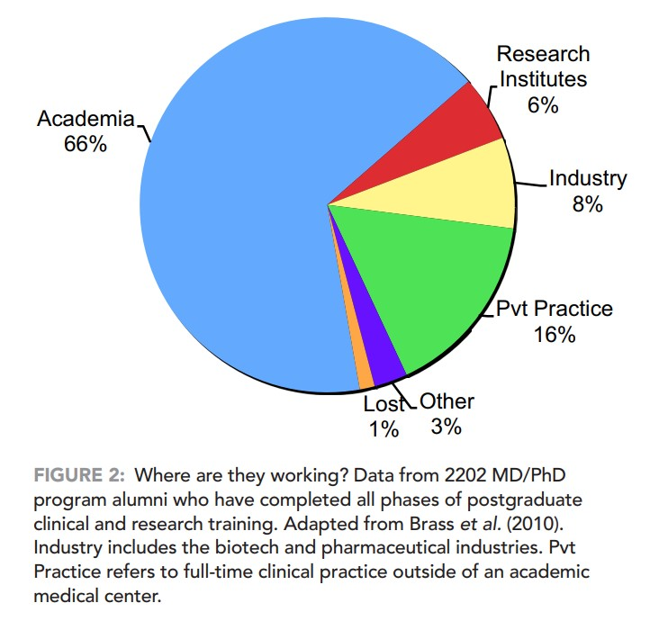
Who are the Physician Scientists
and where do the end up?
From: NIH Physician-Scientist Workforce Working Group Report, 2014
From: Is an MD/PhD program right for me? Advice on becoming a physician-scientist. Brass LF. Mol Biol Cell. 2018 Apr 15;29(8):881-885. doi: 10.1091/mbc.E17-12-0721. PMID: 29668419.

Slide 11
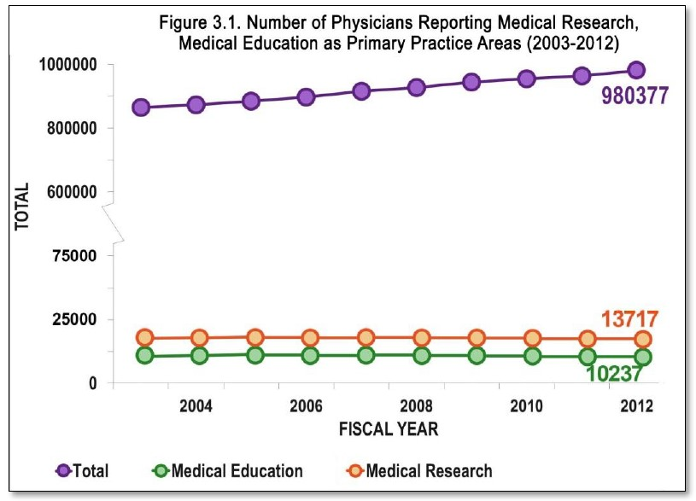
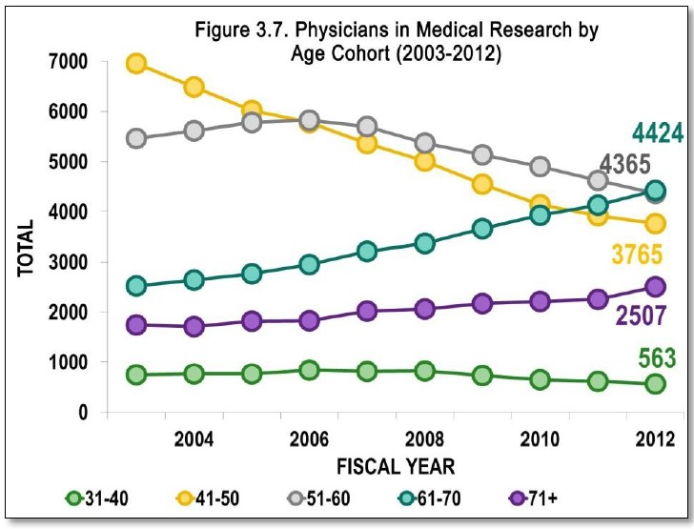
The problem: There aren't very many of you, and those that are, are not getting older and are not being replaced.
1.4%!

Slide 12
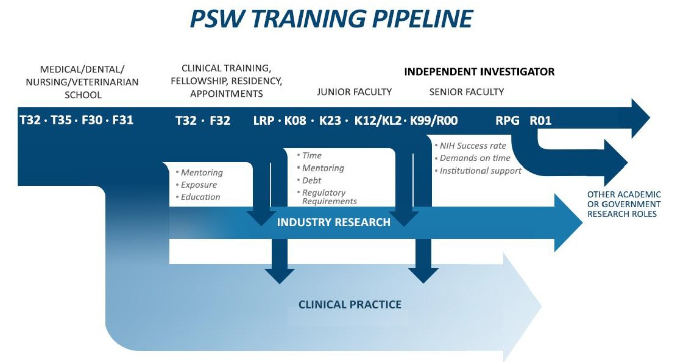
The Pipeline: Sources of Support, Challenges, Outcomes
From: NIH Physician-Scientist Workforce Working Group Report, 2014

Slide 13
Most Relevant Funding Opportunities
Graduate Training Grants and Fellowships (T and F Awards)
T32 Institutional National Research Service Award (NRSA)
F30 Individual NRSA for Dual-Doctoral Degree Students
F31 Individual NRSA for PhD Students
Post-doc Training Grants and Fellowships (T and F Awards)
T32 Institutional National Research Service Award (NRSA)
F32 Individual post-doctoral fellowships
Research Career Development Awards (K Awards)
K08 Mentored Clinical Scientist Research Career Development Award
K23 Mentored Patient-Oriented Research Career Development Award
K12/KL2 Mentored Institutional Research Career Development Award
K99/R00 Pathway to Independence Award
Research Project Grants (R grants)
R01 Investigator-initiated Research Project Grant
R21 Exploratory/Developmental Research Grant
R03 Small Research Grants
LRP NIH Loan Repayment Program

Slide 14
Research Career Development Awards (K awards)
K08 Mentored Clinical Scientist Research Career Development Award
K23 Mentored Patient-Oriented Research Career Development Award
K99/R00 Pathway to Independence Award
Mechanism | Eligibility and Conditions | Length | Mentor Needed | P.I. Salary
Mentored Clinical Scientist Development Award (K08) | M.D., or comparable clinical degree, minimum of 9 calendar months (75%) effort* | 3-5 years, not renewable | Yes | Up to $100,000, plus fringe benefits
Mentored Patient-Oriented Research Career Development Award (K23) | M.D., or comparable clinical degree, minimum of 9 calendar months (75%) effort* | 3-5 years, not renewable | Yes | Up to $100,000, plus fringe benefits.
Pathway to Independence Award (K99/R00) | Ph.D., M.D., or equivalent research degree, with no more than 4 years of postgraduate research training who needs only 2 more years of mentored support before securing a faculty position at a U.S. institution. Minimum of 9 calendar months (75%) effort*. No citizenship requirement. | 2 years for the mentored K99; up to 3 years for the independent R00 phase. | ONLY for the K99 phase. | K99 = up to $75,000 (within the K99 total cost cap of $90,000/yr); R00 = at the institutional level, up to the NIH maximum (within the R00 total cost cap of $249,000/yr)

Slide 15
Scoring of R Grants and K Awards
Scored Criteria for R Awards
(Research)
Investigator(s)
Significance
Innovation
Approach
Environment
Overall Score
Scored Criteria for K Awards
(Career Development)
Candidate
Mentor(s)
Career Development Plan
Research
Environment / Institutional Commitment
Overall Score
Each criterion gets a separate 1-9 score (1 is best).
The Overall Score is not an average but the reviewer’s overall assessment of the
impact that the grant and candidate will have on the research field if the grant is
funded.

Slide 16
Career Development Awards (K Awards) or Fellowships (F Awards)
Scored Criteria
Candidate
Biosketch, training, publications and contributions to science, personal
statements, mentor’s letters, letters of recommendation, general grant
quality
Mentor(s)
Expertise, publications, funding, past mentorship
Career Development Plan
Personal statement, training plan, advisory committee, mentor’s letter
Research
Significance and innovation, scientific rigor, training value, path to an R
Award
Environment / Institutional Commitment
Dept Chair’s letter, protected research time, plans for promotion, start-up
money

Slide 17
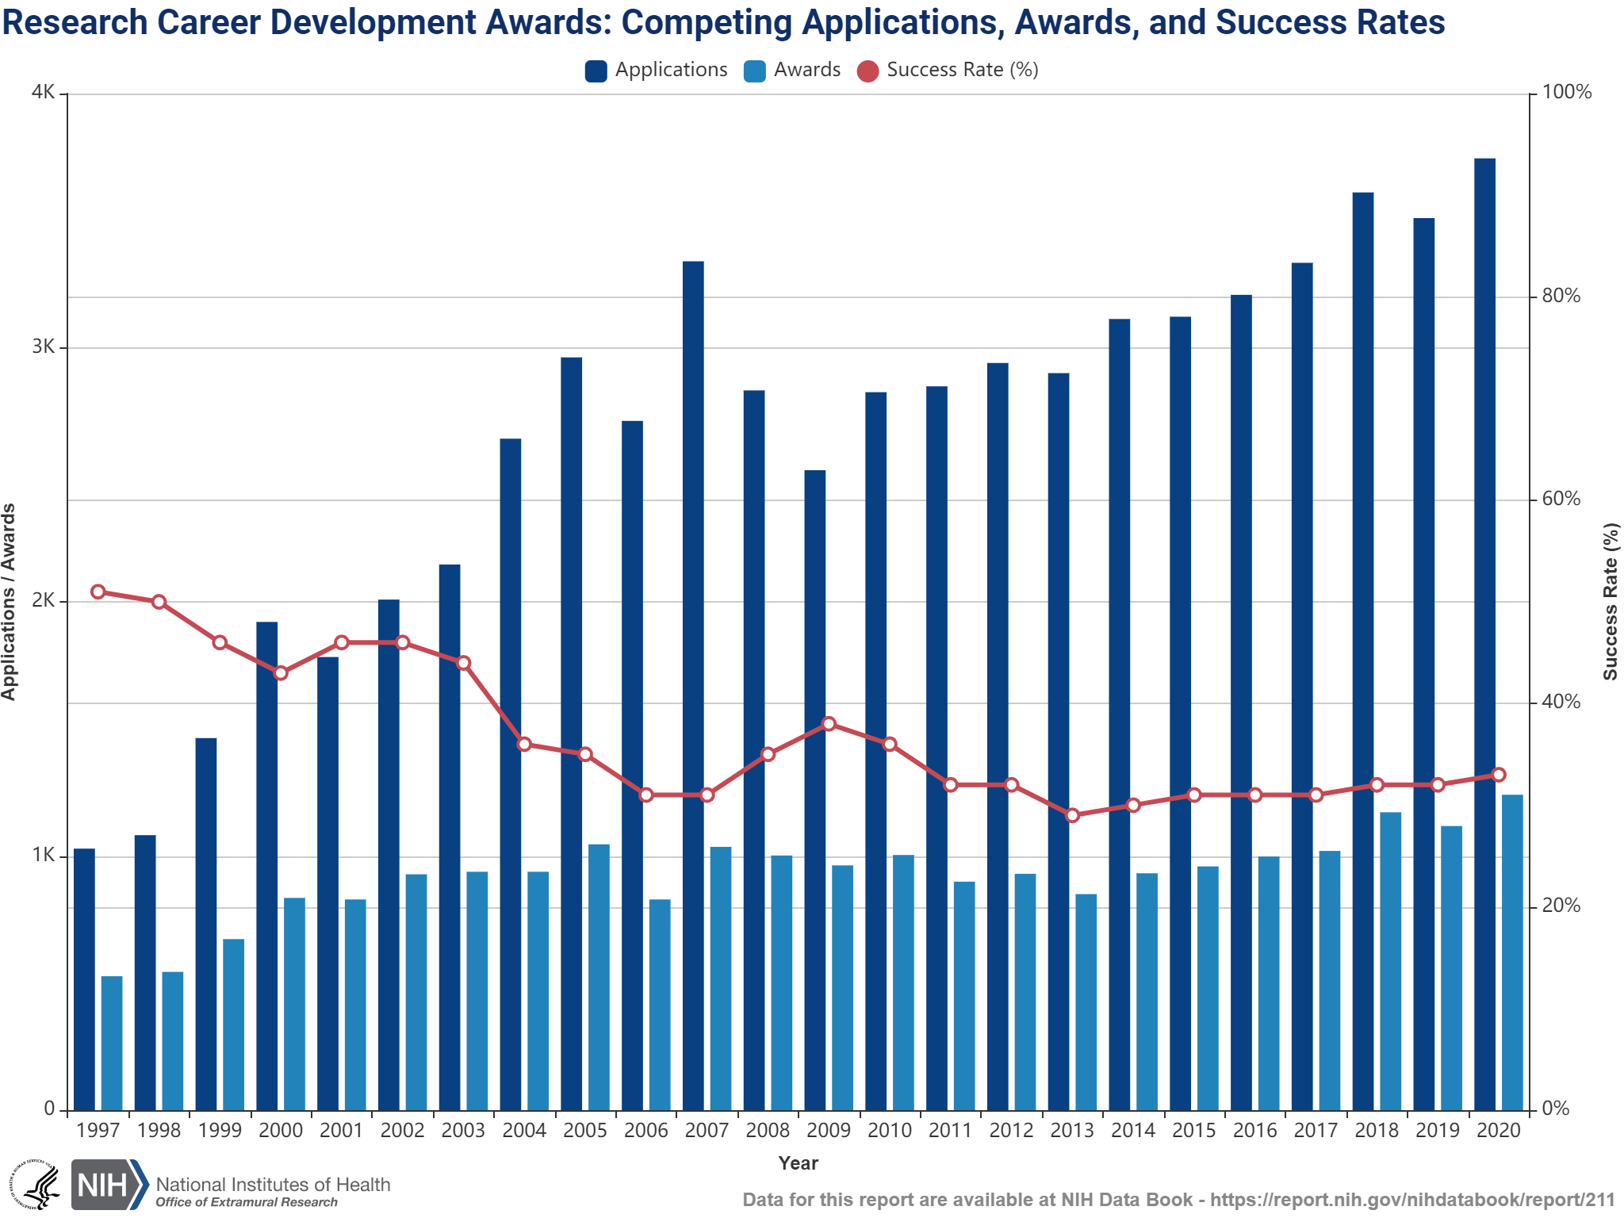
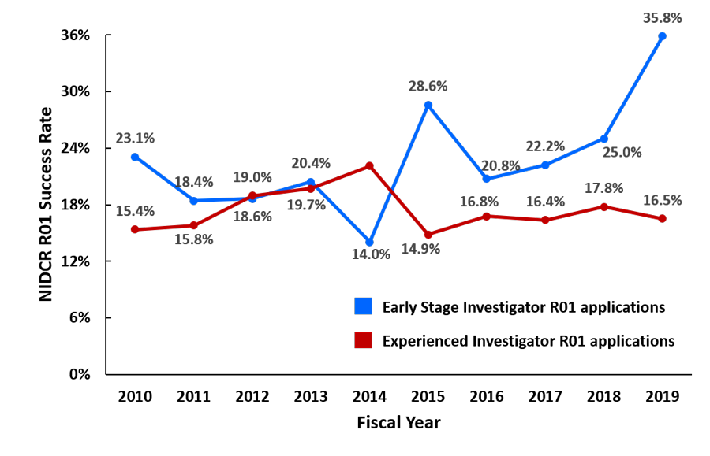
K Awards vs Early Investigator R01 Funding Rates
Both success rates around 30%
Less money
75% FTE requirement
Formal mentorship and training
Much more money
FTE requirement is much less (20-25%)
No formal mentorship or training

Slide 18
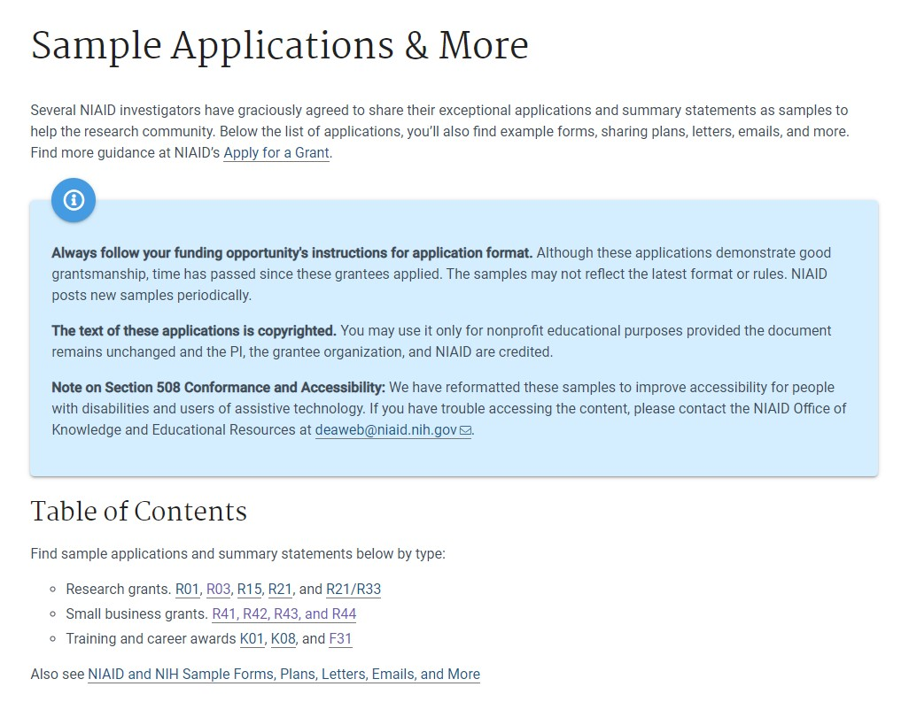
NIH Grant Examples
https://www.niaid.nih.gov/grants-contracts/sample-applications

Slide 19
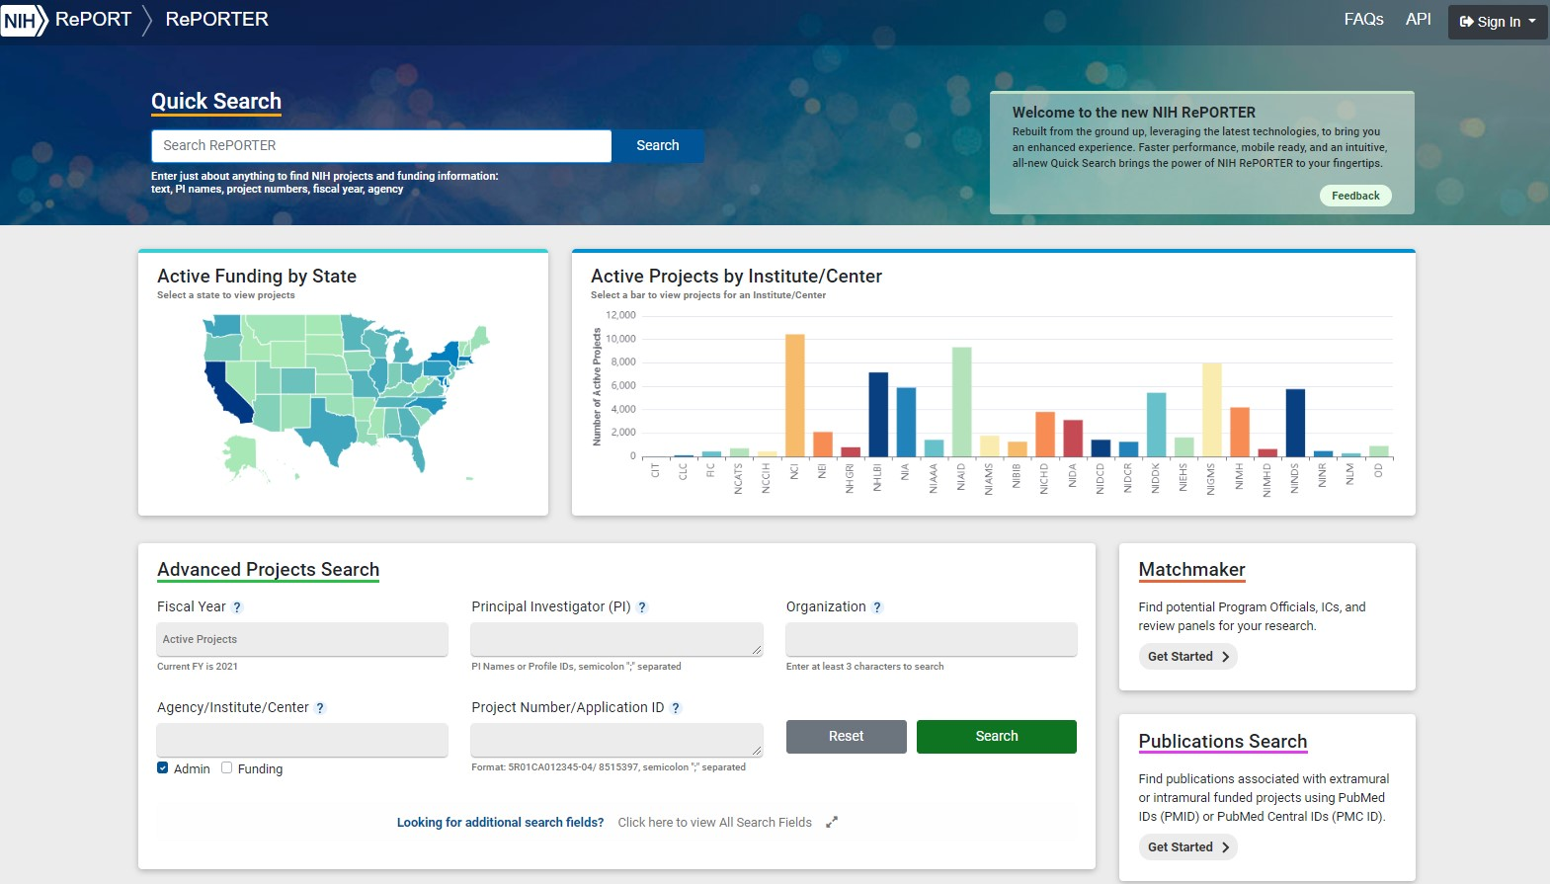
NIH RePORTER
https://reporter.nih.gov/

