Slide 1
How to Navigate the IRB and Study Startup
Medicine Research
Dartmouth Hitchcock Medical Center
February 20th, 2023

Slide 2
Disclosures
No disclosures

Slide 3
Objectives
To provide an overview of what an IRB is and what they do
To provide a high-level overview and actionable steps to conduct research at Dartmouth Hitchcock

Slide 4
What are we not covering?
Research Design
Regulatory Requirements

Slide 5
Why?

Slide 6
Research is complicated!

Slide 7
Acronyms Decoded
DH-IRB: Dartmouth Hitchcock Institutional Review Board
CPHS: Committee for the Protection of Human Subjects (Dartmouth College IRB)
CTO: Clinical Trials Office
eIRB: electronic IRB portal at DH
Rapport: electronic IRB portal at Dartmouth College
SLRQ: Study Level Release Questionnaire
DUA/MTA: Data Use Agreement/ Material Transfer Agreement
AI: Analytics Institute
CTMS: Clinical Trial Management System
PI: Principle Investigator
PHI: Protected Health Information

Slide 8
Other Key Terms:
OnCore: The CTMS for Dartmouth Hitchcock
eReg: Electronic Regulatory Binder, CFR Part 11 compliant
Privacy Office: The office at Dartmouth Hitchcock responsible for protecting PHI
Study Intake: CTO’s term for receiving all materials for their review
Analytics Institute: Responsible for assessing what data can be pulled from Epic in a report, eliminating the need for chart review

Slide 9
What is an IRB?
Formal FDA Definition:
An IRB is an appropriately constituted group that has been formally designated to review and monitor biomedical research involving human subjects. In accordance with FDA regulations, an IRB has the authority to approve, require modifications in (to secure approval), or disapprove research. This group review serves an important role in the protection of the rights and welfare of human research subjects.
Note: you may also see the terms Independent Ethics Committee (IEC), Ethical Review Board (ERB), or Research Ethics Board (REB).
More information: Institutional Review Boards Frequently Asked Questions | FDA

Slide 10
What does an IRB do?
The IRB reviews any research proposal (and at DH, any QI proposal as well), for the following purposes:
To promote the safety and well-being of human participants
To ensure adherence to the ethical values and principals underlying research
To ensure research is scientifically valid
To give confidence to potential participant and the public that the research meets a minimal standard.
At many institutions the IRB also serves as a checkpoint to ensure compliance with local requirements such as PI qualifications, local ICF language, subject injury, etc.

Slide 11
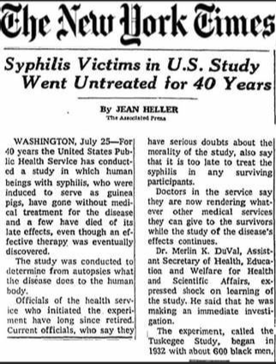
So why do we IRB oversight?

Slide 12
Some light reading…
The Nuremberg Code, 1947
The Declaration of Helsinki, 1964
The Belmont Report, 1978

Slide 13
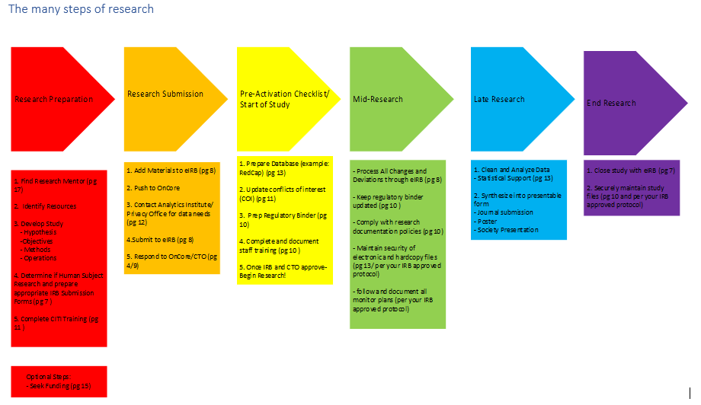

Slide 14
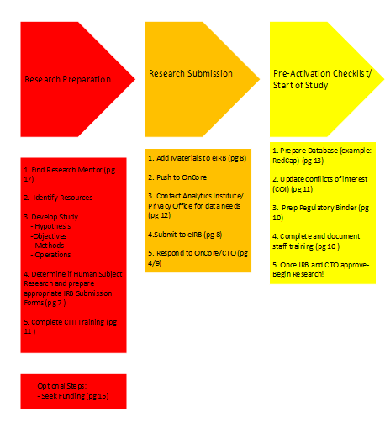

Slide 15
Which IRB do you need?
HRRP (IRB) Submission Decision Questions | Research | DHMC and Clinics (dartmouth-hitchcock.org)
Is the Principal Investigator employed by Dartmouth Health? o Yes o No
Does the study utilize any Dartmouth Health data or specimens? o Yes o No
Does the study enroll any patients from Dartmouth Health or recruiting from Dartmouth Health sites? o Yes o No
Does the study utilize any Dartmouth Health resources? This includes study procedures taking place at a Dartmouth Health location, or using Dartmouth Health equipment or shared resources. o Yes o No

Slide 16
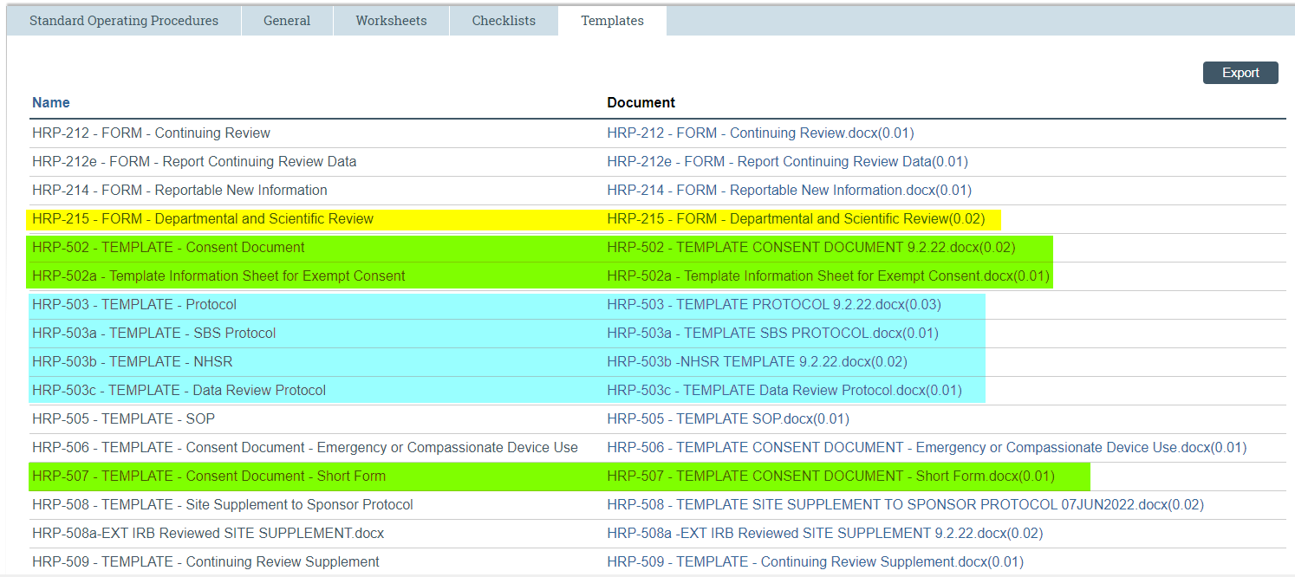
Prepare your IRB submission
Tips: Explore the IRB library https://www.dartmouth-hitchcock.org/research/hrpp-irb

Slide 17
CITI Training! https://www.citiprogram.org/login
Tips:
Make sure you affiliate with Dartmouth Health!
You must complete:
Good Clinical Practice: GCP for Clinical Trials with Investigational Drugs and Medical Devices (U.S. FDA focus)
Biomedical Responsible Conduct of Research
Human Subject Research: Biomedical Research Investigators
Conflict of Interest

Slide 18
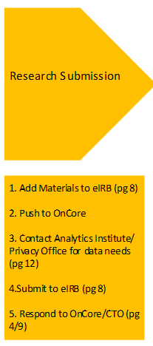
IRB Submission https://dhirb.huronresearchsuite.com/
Tips for Steps 1, 2, and 4:
Remember your HRP-215 (Dept/Sci review form)
Should be completed following departmental practice of the PI or clinical partner
“Push to OnCore” as soon as you have the minimum footprint uploaded
The Department should be the home department of the PI or clinical partner
Only the PI can actually “Submit” the study. If you are not the PI, consider requesting the PI assign you proxy access to manage all future IRB work
Watch for IRB communications, required edits, etc.

Slide 19
AI/ Privacy Office Considerations- Don’t wait!
AI takes 7-10 days for initial review
Complete the data request form and submit to AI via DHSM ticketing system
Data requests currently take 3-4 weeks
If your data requests include PHI, you will also need Privacy Office review before AI can proceed.

Slide 20
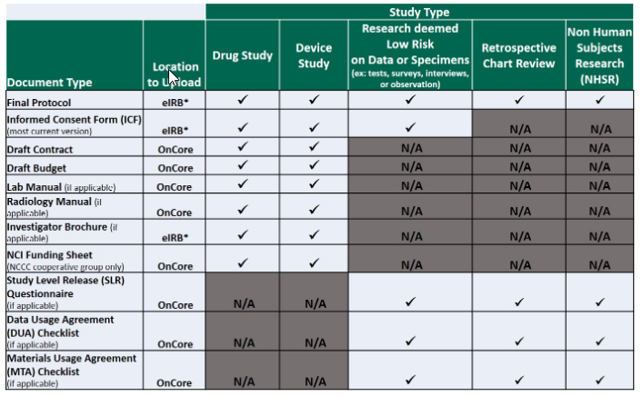
CTO: Business Review https://one.hitchcock.org/intranet/departments/dartmouth_clinical_trials_office/new_study_start_up
CTO email: Don’t ignore!
Minimum documents must be uploaded to OnCore. If no one on the study has OnCore access request ORO support.
These flow from the IRB
Protocol
ICF
Investigator Brochure

Slide 21
CTO continued
What does the CTO Do?
Business and compliance review
They need the SLRQ to support this! https://one.hitchcock.org/intranet/docs/default-source/research-operations/slr-questionnaire.pdf?sfvrsn=6fea371c_4
What is the SLRQ?
Questionnaire walking the CTO through who is involved with enough data to determine what agreements are needed to support the research
Who do you contact?
CTO@Hitchcock.org
Include your IRB study number in the subject line!
How do you know when review is complete?
You’ll get a notification via email indicating “Open to Accrual” or “CTO Signoff Complete”

Slide 22
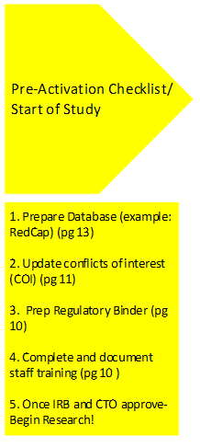
You have CTO and IRB approval- Now What?
Start your research!
If you require Data from AI, send your IRB approval along with your data request

Slide 23
Final Considerations
Don’t neglect your regulatory management
Make sure to submit any changes to the IRB and CTO through modification and amendment processes (instructions on each site)
If you are consenting subjects, you will need OnCore access for subject management during the life of the study: OnCore & eReg Access (hitchcock.org)
If your research is IND/IDE you will need to use eReg
Start early; everything takes longer than you expect!

Slide 24
Questions?

