Slide 1
Curriculum Vitae
Graham Atkins
October 19, 2023
BSc (Hons), MBChB, MRCP(UK)
Assistant Professor of Medicine
Attending Physician, PCCM
Program Director IM Residency

Slide 2
In English, a curriculum vitae, Latin for "course of life", often shortened to CV) is a short written summary of a person's career, qualifications, and education.
In North America, the term résumé (also spelled resume) is used, referring to a short career summary.

Slide 3
TL:DR
Capture everything
Edit / format for the audience

Slide 4
You: “Capture everything – does that include my job as a dog walker and my grades in high school?”
Me: “Probably not”
You: “What about being captain of the basketball team or my volunteer work?”
Me: “Maybe”
You: [Thinks to self this guy’s not much help]
“Ok, well reformatting is a pain, do I really have to do it?”
Me: “Yes”
You: “This isn’t really helping me”
Me: [My taciturn responses were the perfect set up to drop this great quote about wisdom and starting at the finish but now I’ve forgotten it!]
“Let’s look at some CV templates”

Slide 6
AAMC CV Template

Slide 8
Geisel Faculty CV Template

Slide 9
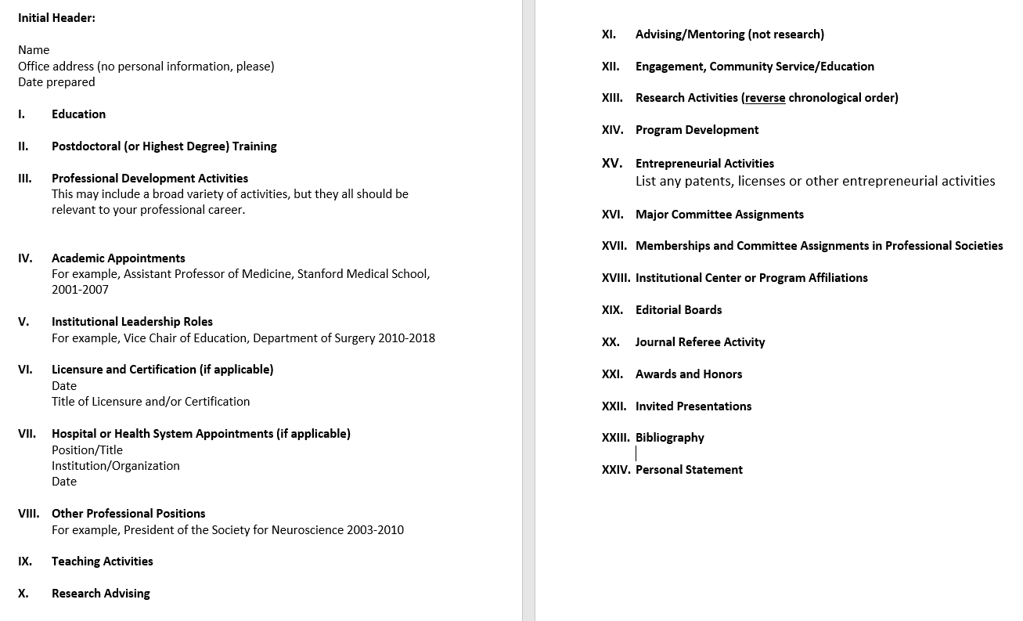

Slide 10
NIH BioSketch

Slide 11
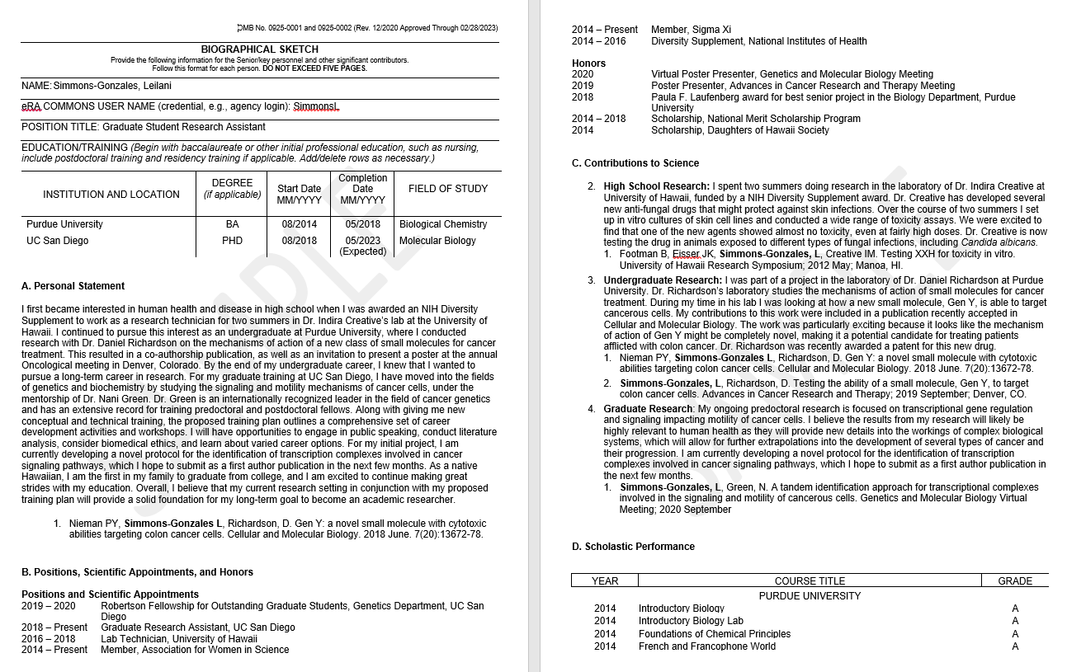

Slide 12
ERAS CV Template

Slide 13
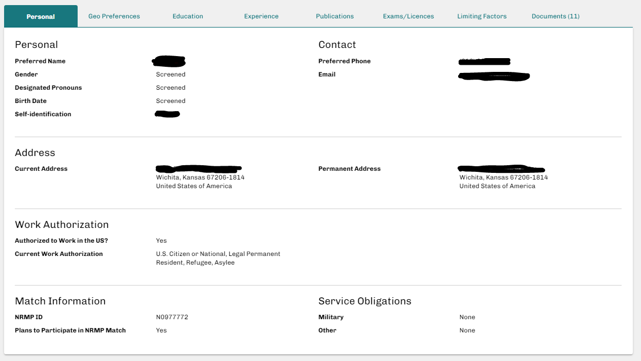

Slide 14
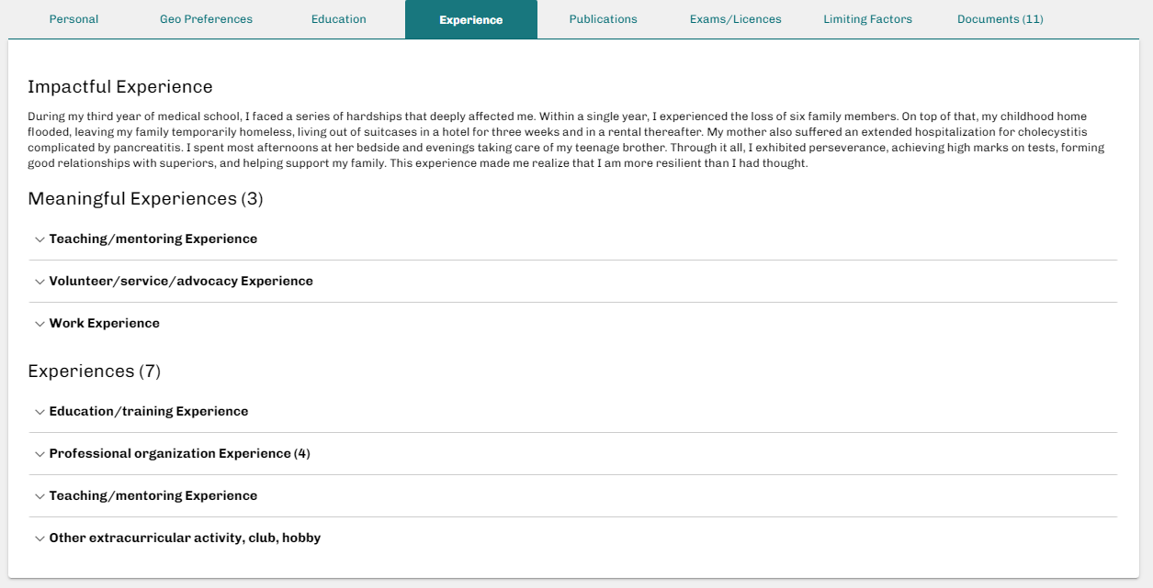

Slide 15
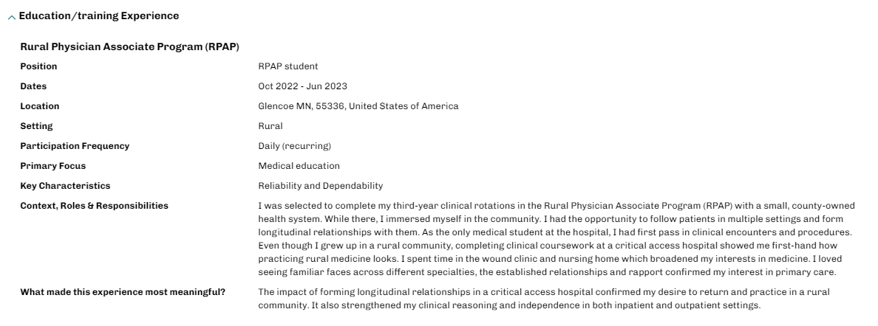

Slide 16
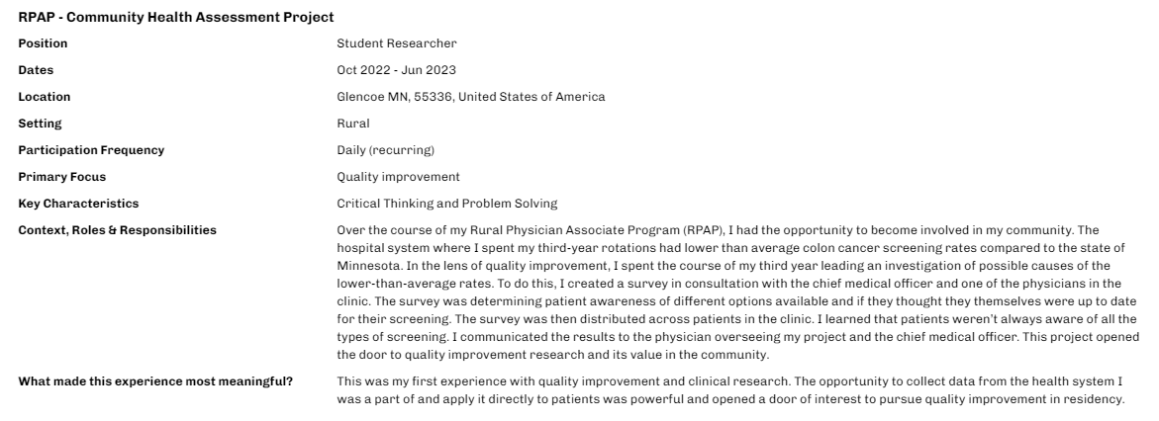

Slide 17
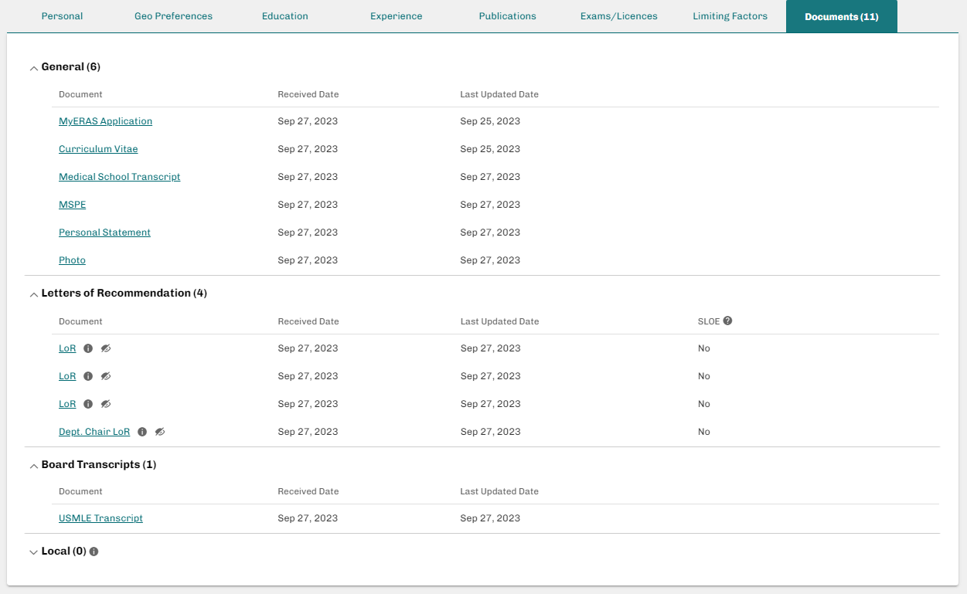

Slide 18
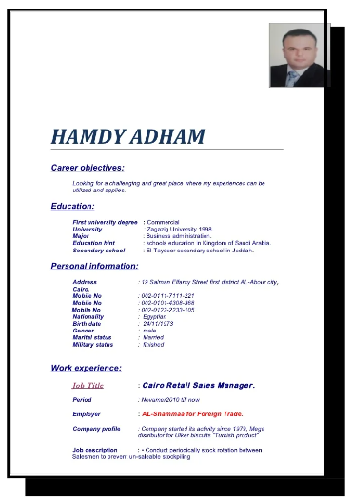
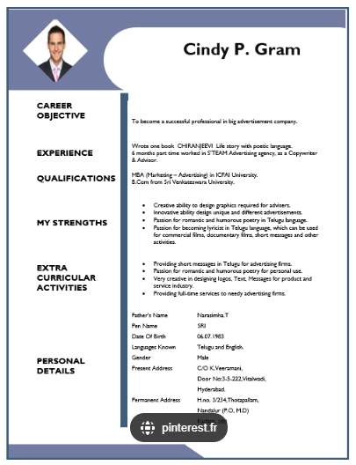
“Bad” CV templates

Slide 19
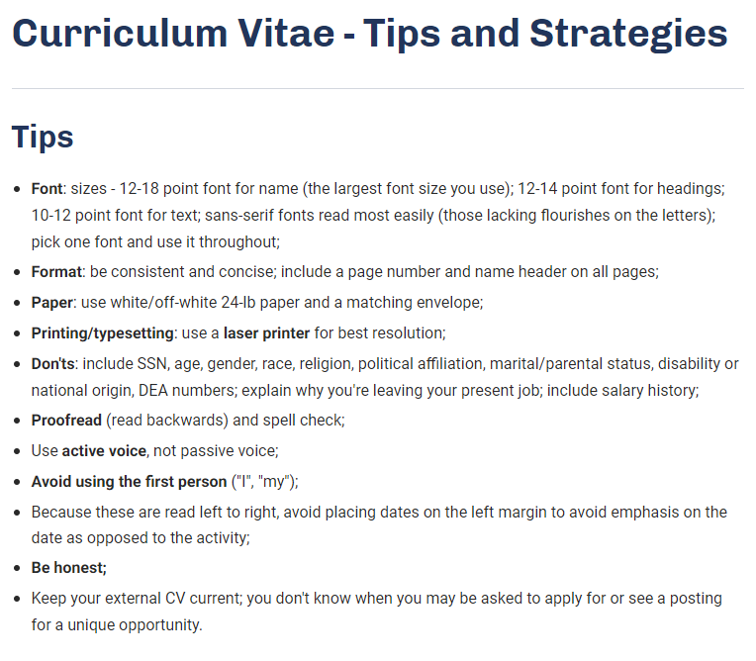

Slide 20
Make it easy for the reader
Literally make it easy to read. Keep it concise but I think 3 pages of clear and well spaced text is better than 2 pages that are cramped
Make it easy to understand chronologically, no gaps in the timeline

Slide 21
Summary
Write down everything you do in med school
Pick a format that works for you. “master” CV. AAMC template a good place to start.
No graphics or fancy layouts, avoid noise, maximize signal
Add one or more miscellaneous sections to help you capture things that don’t fall neatly under the headings (right now you might add “Experiences” and “Personal Statement” thinking ahead to the ERAS application)
Be prepared to edit and reformat on a regular basis

