Slide 1
What Will I Do for First Year Summer?
Advice for our first year students

Slide 2
Frequent First Year Summer Questions
I definitely want to do research or gain exposure to a specialty. What are my next steps?
I’m not sure if I want to do research, but I feel like I should…
I do NOT want to work this summer. I need a break! Will that hurt me when applying to residency programs?
GEISELMED.DATMOUTH.EDU

Slide 3
Careers in Medicine
Alison Holmes, MD, MPH
Associate Dean of Student Affairs

Slide 4
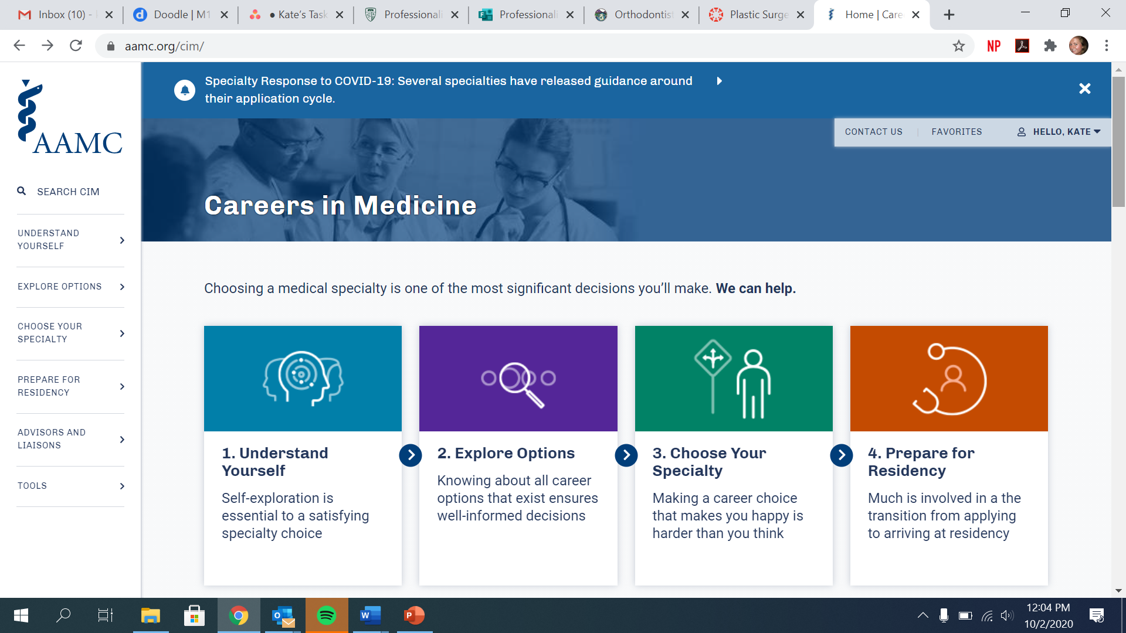
AAMC CiM
https://www.aamc.org/cim/
GEISELMED.DARTMOUTH.EDU

Slide 5
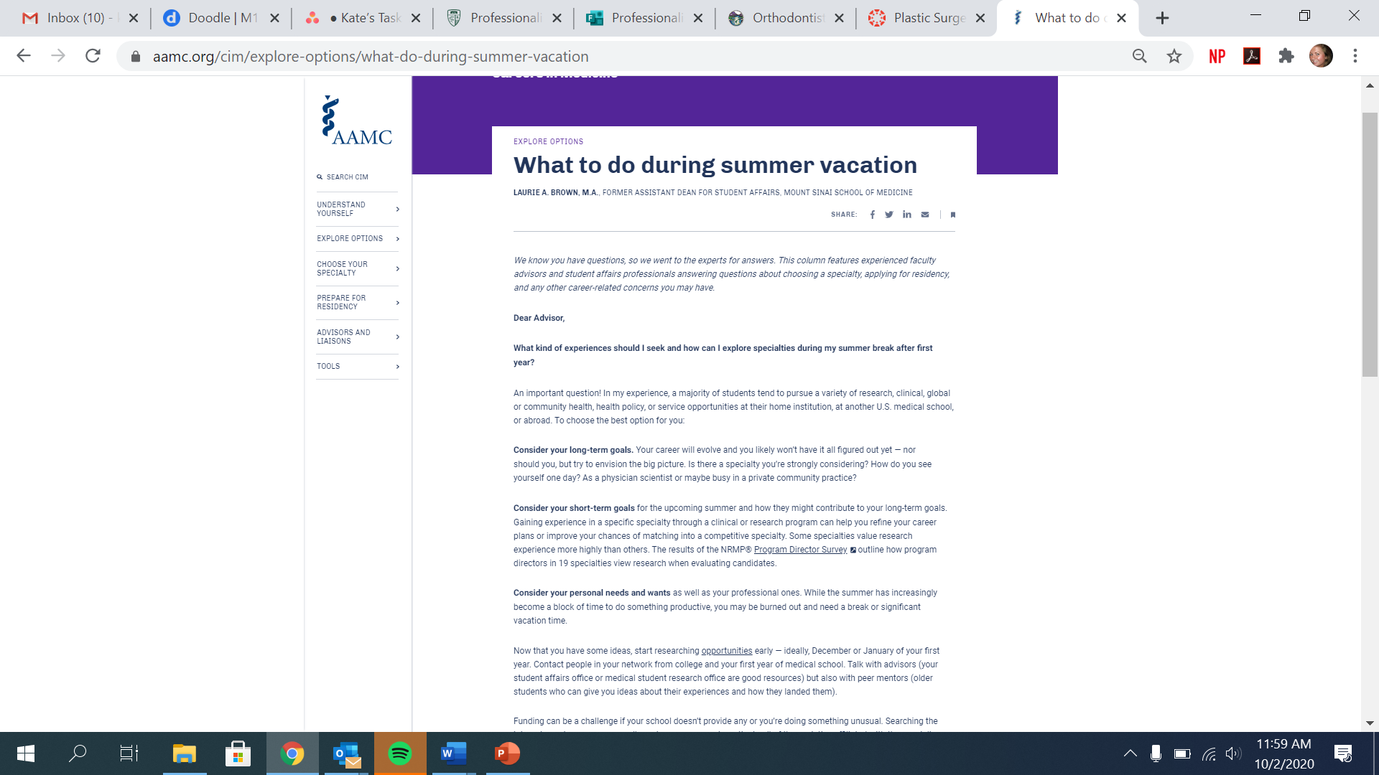
AAMC CiM: Careers in Medicine
https://www.aamc.org/cim/explore-options/what-do-during-summer-vacation
GEISELMED.DARTMOUTH.EDU

Slide 6
Where to Find Opportunities and Help with the Process
Notes:
Ask Alison and Tim about these slides

Slide 7
A project away from Geisel

Slide 8
AAMC CiM Research Database
https://apps.aamc.org/cim-cr-web/#/user
GEISELMED.DARTMOUTH.EDU

Slide 9
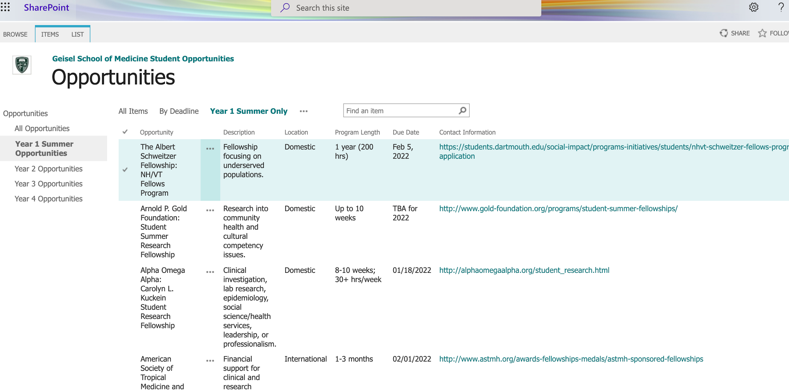
Geisel Summer Research Database
https://dartmouth.sharepoint.com/sites/MedicalEducation/CHE/Lists/Opportunity/AllItems.aspx
GEISELMED.DARTMOUTH.EDU

Slide 10
Summer Opportunities Database
View opportunities:
How to access:
https://dartmouth.sharepoint.com/sites/MedicalEducation/CHE/Lists/Opportunity/Opportunities%20Year%201%20Summer%20Only.aspx
Alphabetically
By deadline
Year specific
Specialty Interest
Family Medicine
Pediatrics
Surgery
Psychiatry
OB/GYN
Oncology
Global Health
Public Health
Health Policy
Geisel Student Affairs site
↓
Student Resources page
↓
Student Opportunities Database
GEISELMED.DARTMOUTH.EDU

Slide 11
Application Assistance
Letters of recommendation and applications:
Start by writing your first draft of letter/application
Send to coach or trusted faculty for revisions
Send to Kate Adams for revisions
Submit the LOR draft, the due date, the link or email for submission and an updated copy of your CV to Kate.E.Adams@Dartmouth.edu at least two weeks before the program deadline.
Kate Adams
Student Affairs Program Coordinator
Kate.E.Adams@Dartmouth.edu
Support with CV
Go to canvas advising link for workshop recordings, examples and more
https://dartmouth.instructure.com/courses/29418/pages/how-to-create-a-medical-curriculum-vitae
Email Kate Adams to review
GEISELMED.DARTMOUTH.EDU

Slide 12
Three ways to find a project at Geisel
Notes:
Ask Alison and Tim about these slides

Slide 13
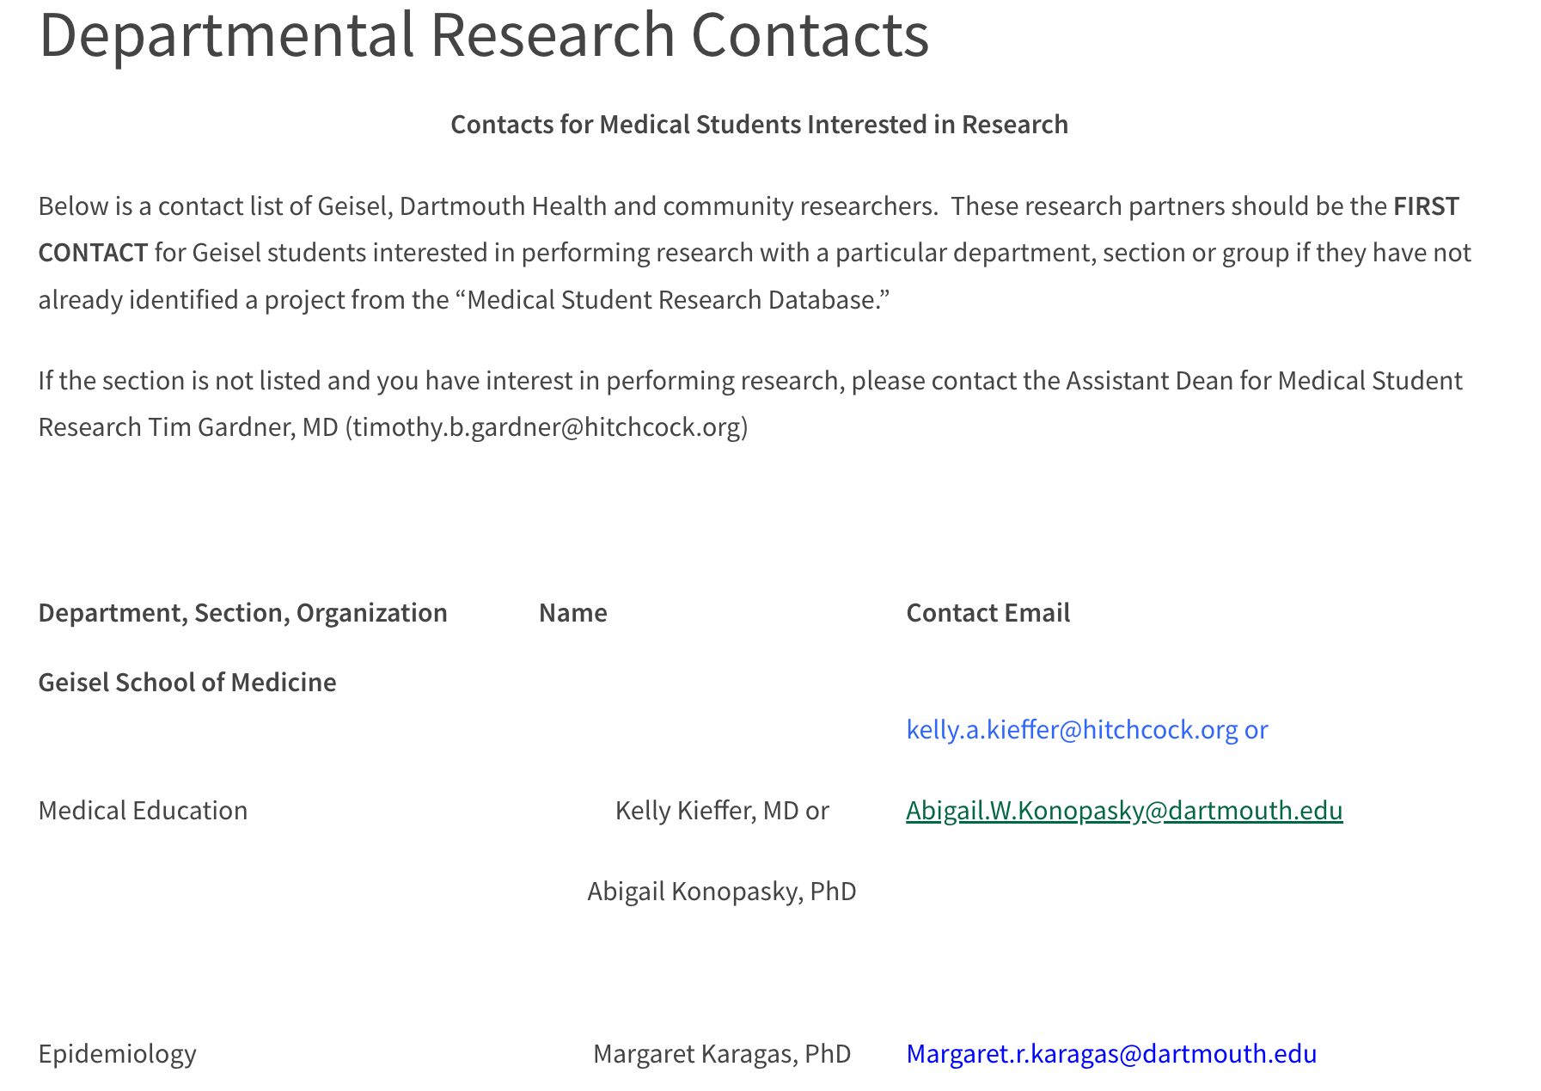
Pick a Department

Slide 14
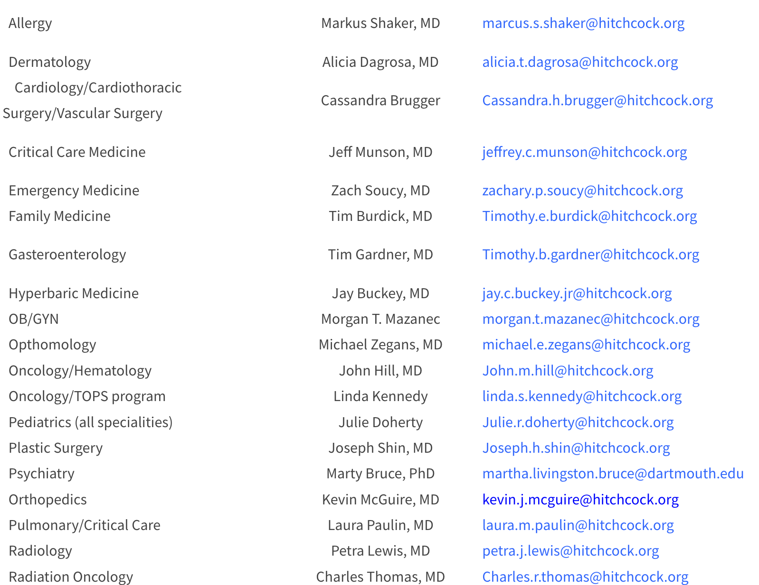
Pick a Department

Slide 15
2. Pick a project in February
1.Faculty name: Isabella Martin, MD
Department: Pathology and Laboratory Medicine
Project description: Chart review project to determine treatment practices for Lyme disease in response to Lyme serology test results.
2. Faculty Name: Matthew A. Roginski, MD, MPH
Departments: DHART, Emergency Medicine, Critical Care Medicine
Project Description: This summer project involves evaluation of the sedation in critically ill patients who are mechanically ventilated and transported by the Dartmouth-Hitchcock Advance Response Team (DHART).
3. Faculty Name: Joseph Paydarfar MD
Department: Surgery – Otolaryngology
Project description: Developing and testing technologies for image guided surgical navigation for throat cancer surgery.
Will be reaching out to Faculty for new projects in Jan 2023.
Stay tuned for list later in February.

Slide 16
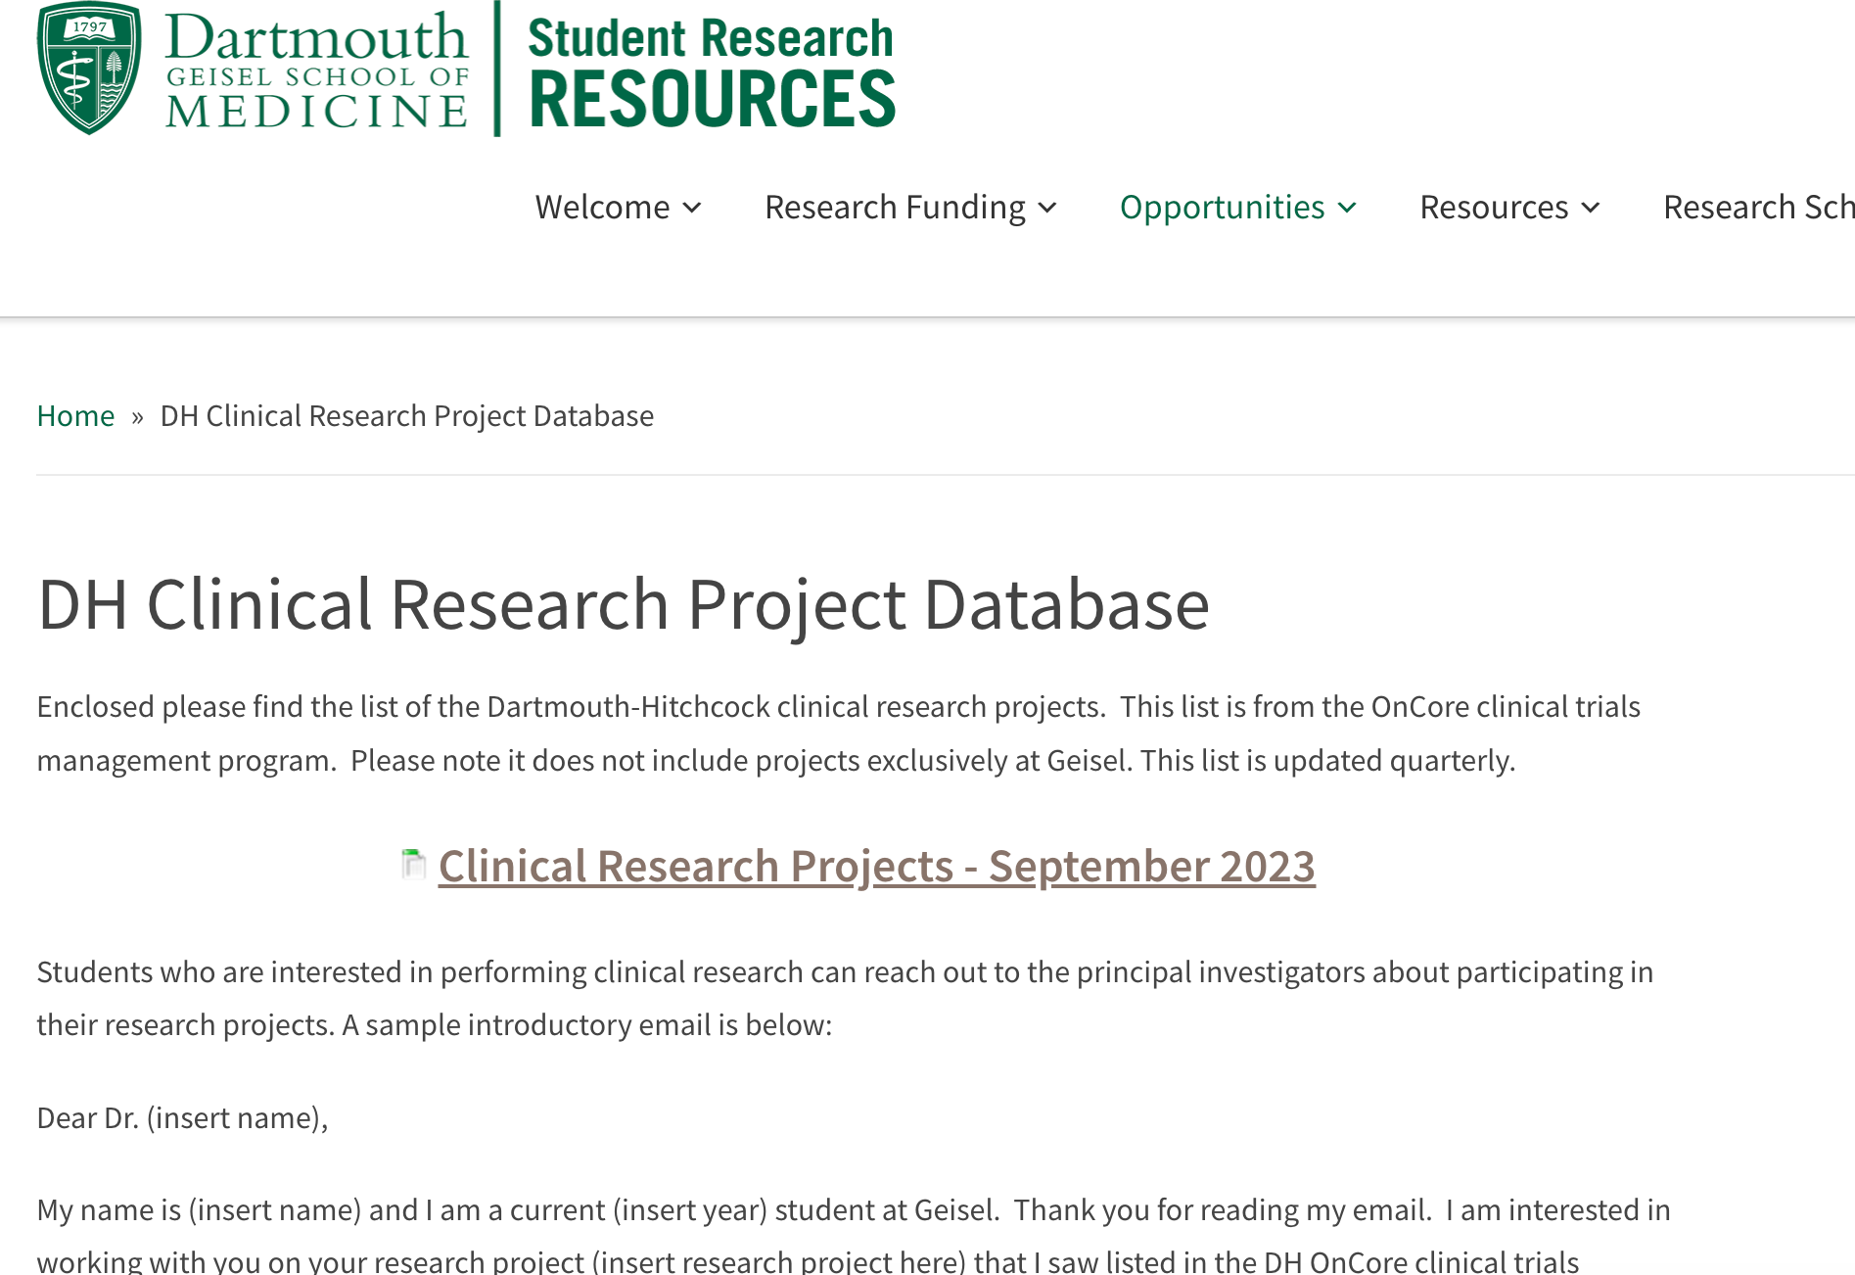
3. Use the new database
1797

Slide 17
To do list:
CITI Training
eDH access
IRB system
Clinical system requirements
Notes:
Double check with Scottie/Tim/Alison

Slide 18
What types of projects have other Geisel students completed?

Slide 19
Sample of 2022 Poster Presentations
GEISELMED.DARTMOUTH.EDU
Notes:
Ask Tina for updated list

Slide 20
Sample of 2022 Poster Presentations
GEISELMED.DARTMOUTH.EDU
Notes:
Ask Tina for updated list

Slide 21
Financial Aid Work Study Program
Michelle Chamley
Assistant Director of Financial Aid

Slide 22
Work Study Program Requirements
Must be a current financial aid recipient
Complete aid application
Complete funding application
One job– on campus
Applications available in February, due back by April 1st
200 hours to earn the full stipend
GEISELMED.DARTMOUTH.EDU

Slide 23
Information from the Registrar’s Office
Stephanie Cummings
Records and Service Specialist

Slide 24
Know Your Application Requirements
Read the application requirements carefully and plan ahead to allow time for requesting and receiving the necessary information you need for submission.
You may need a letter stating that you are a full-time matriculated medical student enrolled at the Geisel School of Medicine (enrollment letter, letter of good standing, etc.).
This is different than a letter of recommendation
There is no fee for this letter
To request a letter, complete the online “Letter Request Form” found on the Geisel Registrar’s webpage
Allow 3-5 business days for processing
You may need a transcript, which you can order through DartHub. Please see “Geisel Transcript” on the Geisel Registrar’s webpage for details regarding ordering transcripts.
Contact the Geisel Registrar’s Office if you have any questions about letters of good standing or transcript requests.
Email: Geisel.Registrar@Dartmouth.edu
– Phone: 603-650-2248
GEISELMED.DARTMOUTH.EDU

Slide 25
Requesting Letters of Good Standing
Requesting Letters of Good Standing
Complete the online “Letter Request Form” found on the Geisel Registrar’s webpage
GEISELMED.DARTMOUTH.EDU

Slide 26
Residency Considerations
Alison Holmes, MD, MPH
Associate Dean for Student Affairs

Slide 27
Very few . . . ENT Dermatology Ophthalmology Orthopaedics Plastic Surgery Neurosurgery Should I cover all the bases? No . . .
Which specialties prefer research IN the specialty?

Slide 28
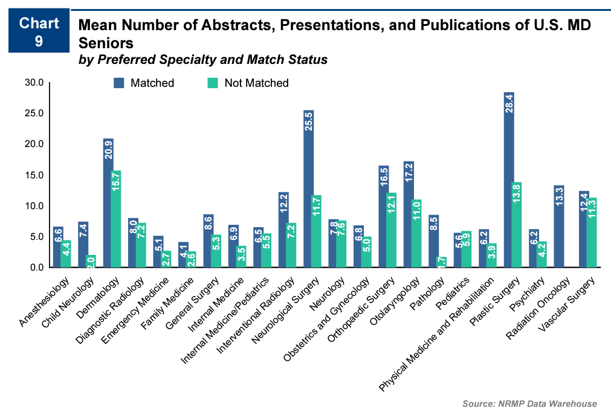
Publications graph
Interpreting the NRMP publications data

Slide 29
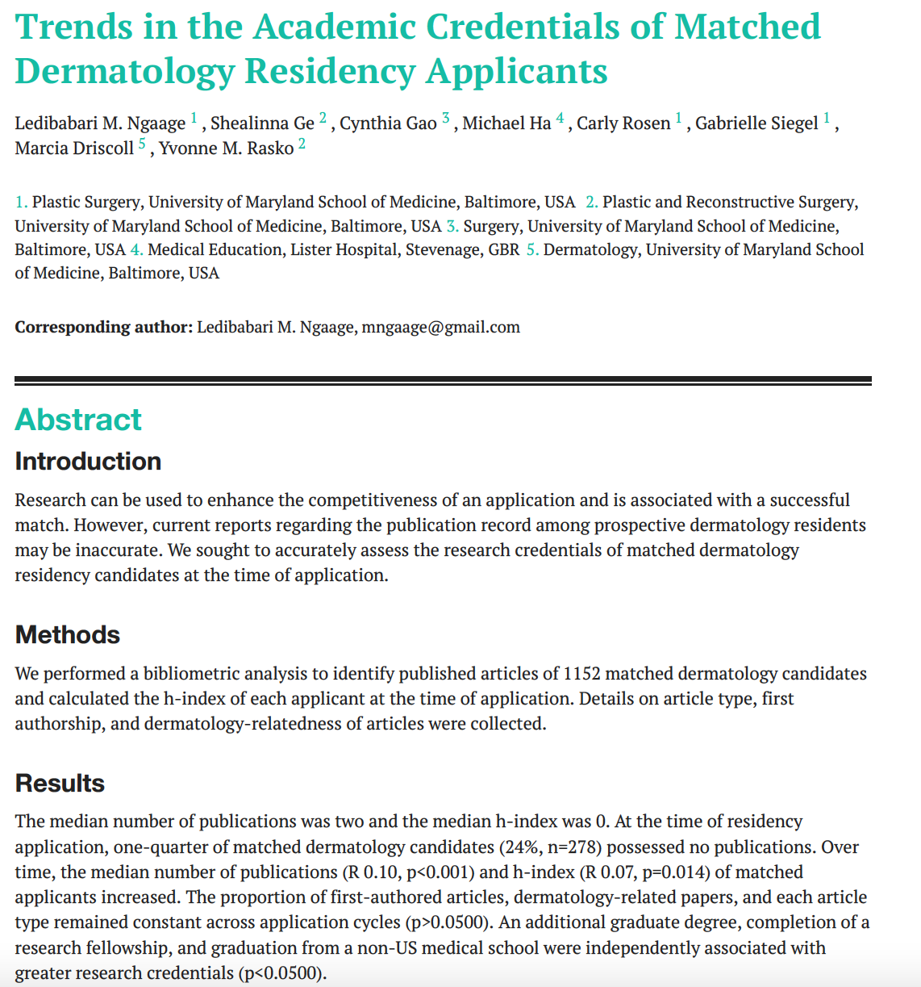

Slide 30
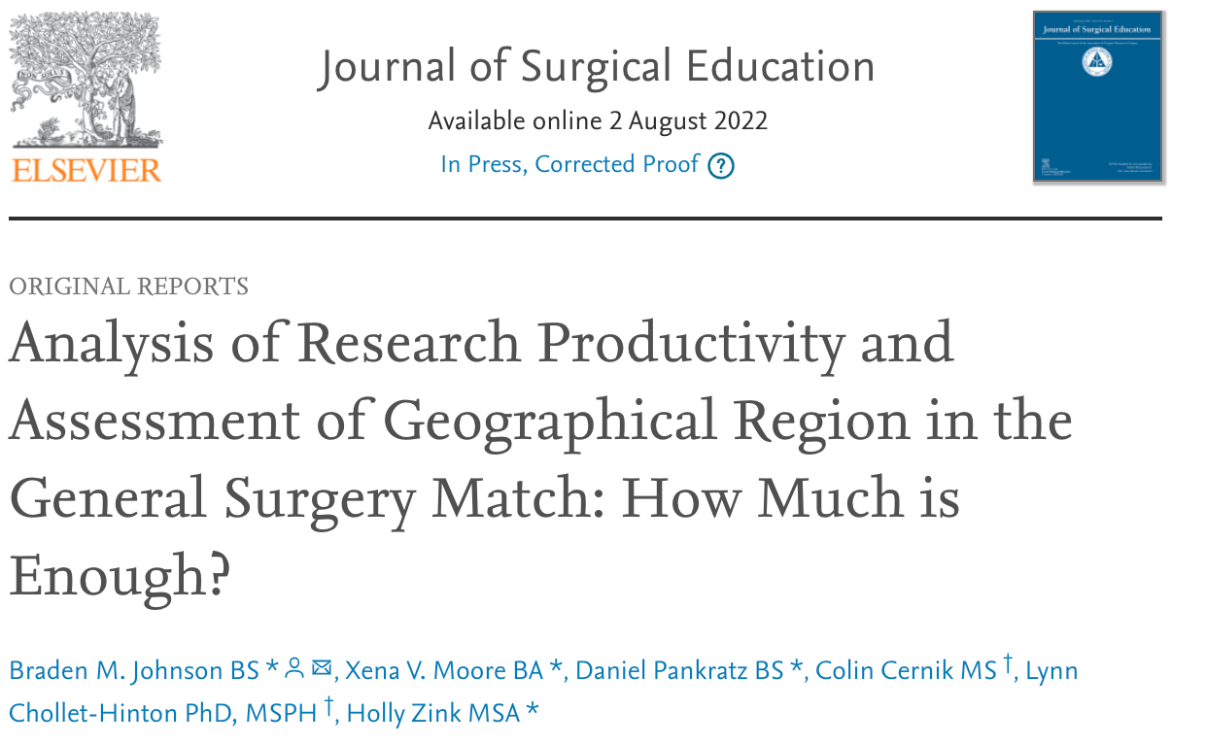

Slide 31
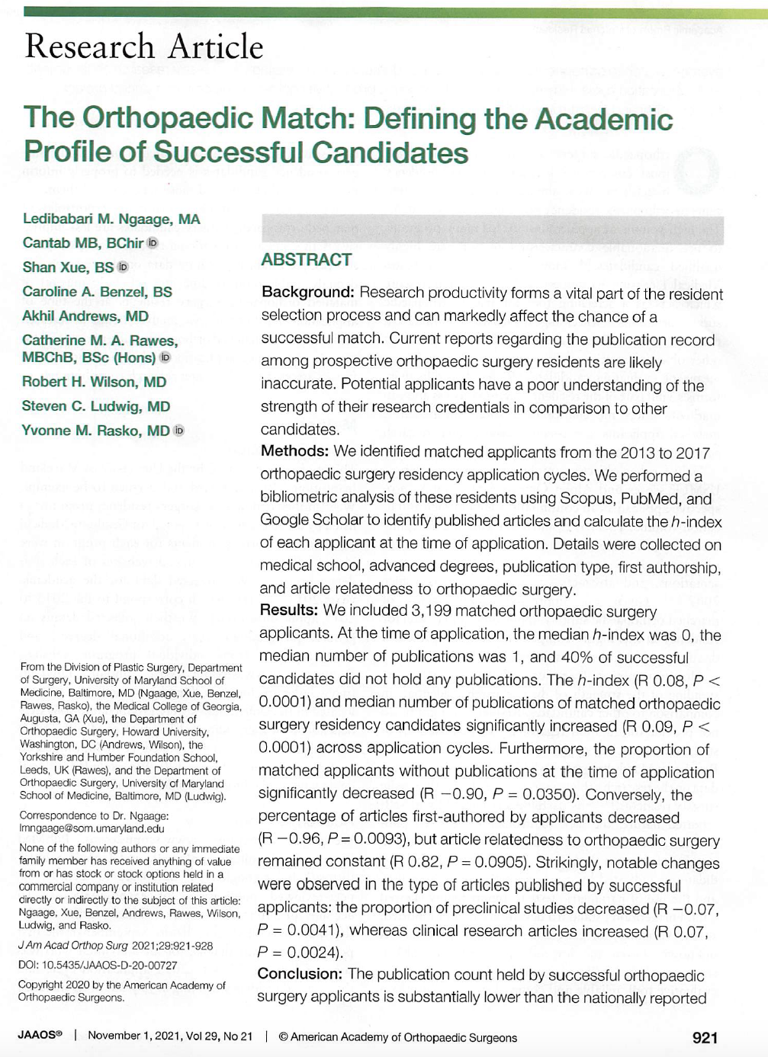

Slide 32
Med Ed Projects
LCME student projects
1. Simplifying Student Access to Research Opportunities and Onboarding for Research Projects
Faculty: Dr. Sonia Chimienti, Dr. Taryn Weinstein, Dr. Gardner- Assistant Dean for Career Advising
Students: Kenneth Greco, Shahin Shahsavari
2. Creating a Campaign for a Positive Learning Environment
Faculty: Dr. Sonia Chimienti, Director for the Learning Environment (TBD)
UME Staff: Amy Rose
Student: Constance Fontanet
GEISELMED.DARTMOUTH.EDU

Slide 33
Med Ed Projects
LCME student projects continued
3. Phase 1 and Phase 2 Self-Directed Learning: an audit and alignment of expected time to prepare for in-person learning – too much, too little or just right?
Faculty: Dr. Virginia Lyons
Students: Tamar Mosulishvili, John Emery
4. Student Mistreatment: Promoting Learning Resource Equity at Geisel
Faculty: Dr. Bill Eidtson
UME Staff: Amy Rose
Student: Macri Gil Diaz
GEISELMED.DARTMOUTH.EDU

Slide 34
Med Ed Projects
LCME student projects continued
5. Integrating and Expanding Education in Clinical and Translational Research
Faculty: Dr. Virginia Lyons, Dr. David Mullins
Student: Michelle Dong
6. Expanding and Integrating the RHE Curriculum at Geisel
Faculty: Dr. David Mullins, Dr. Roshini Pinto-Powell, Dr. Leah Matthew
UME Staff: Stephanie Gardner
Students: Allison Booher, Chinmayee Balachandra
7. Creating SMART Surveys to Positively Impact Program Evaluation
Faculty: Dr. Nancy Barbour
UME Staff: Alayna Sharp, Amy Rose
Student: Helen Thomason
GEISELMED.DARTMOUTH.EDU

Slide 35
Students!

