Slide 1
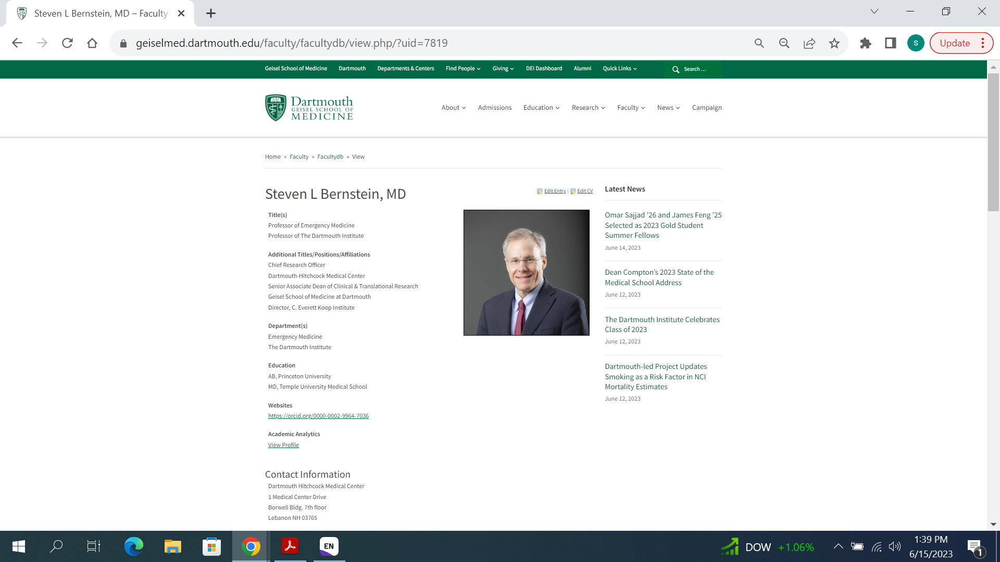

Slide 2
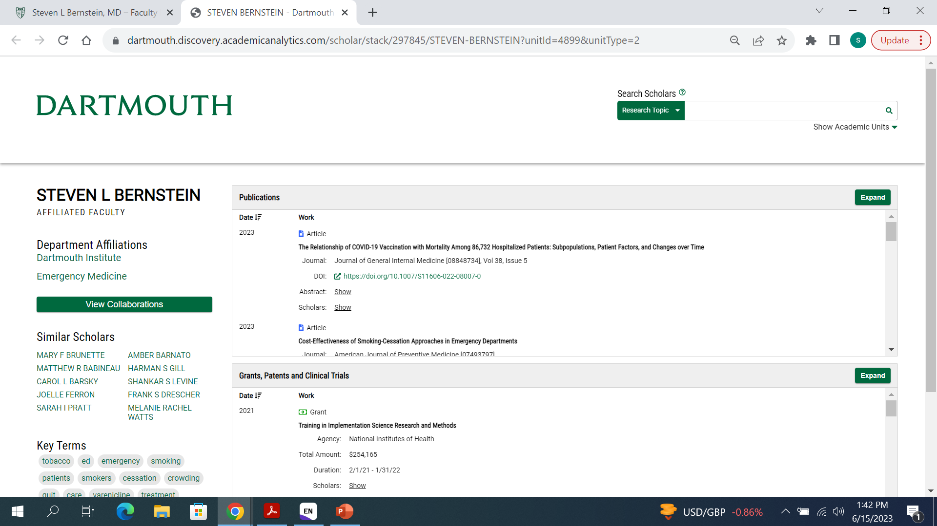

Slide 4
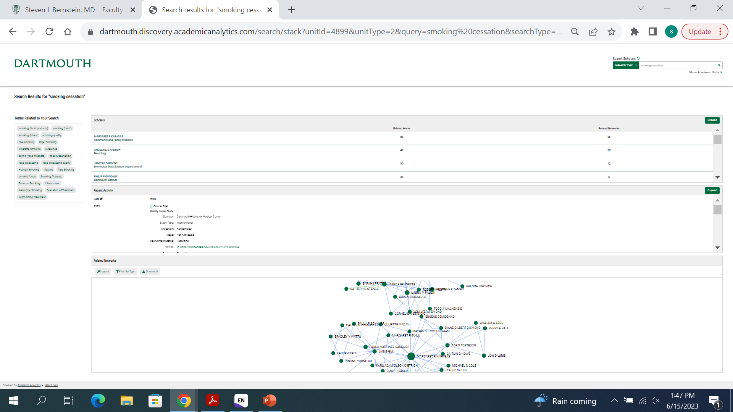
Dartmouth faculty with relevant papers
Relevant trials and papers at Dartmouth
Social network of Dartmouth authors

