Slide 1
Brain Death Scintigraphy:
Diagnosis with Examples
Jeffrey Jones, MD
DHMC Radiology Resident

Slide 2
Brain Death Scintigraphy
Role:
Determine if there is cerebral blood flow
Brain without a blood supply is dead
Elevated ICP from tissue edema or mass exceeds systemic arterial pressure → no intracranial blood flow → brain death
Radiotracers used at DHMC (Lipophilic type)
radiotracer flows to brain → diffuses across blood brain barrier → extracted by brain tissue and trapped
Types
Tc-99m HMPAO (Ceretec®)
Tc-99m ethylene cysteinate dimer (ECD) (Neurolite ®)

Slide 3
DHMC Brain Death Protocol
Patient preparation
None, prefer not hypothermic
Radiopharmaceutical
Technetium-99m HMPAO or ECD
Instrumentation
gamma camera with low energy all purpose parallel hole collimator
Procedure
Head in anterior projection
Dose administered
Imaging started 15-30 minutes later
SPECT imaging of head performed for 20 minutes
Reformats created in axial, sagittal, and coronal planes

Slide 4
Generalized Findings
“Normal”:
Symmetric uptake in all portions of brain
Brain injury (not brain dead):
Patchy areas of absent or diminished uptake
Brain Death Findings:
No radiotracer uptake in ALL portions of the brain including the cerebellum and brainstem
“Empty box” appearance

Slide 5
DHMC Examples

Slide 6
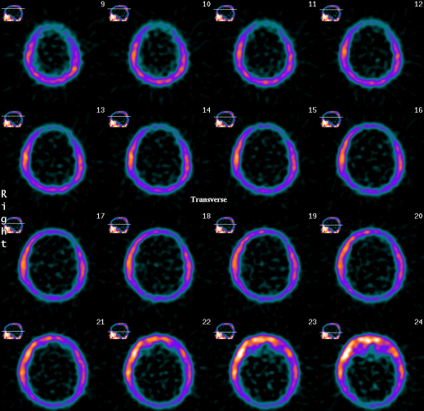
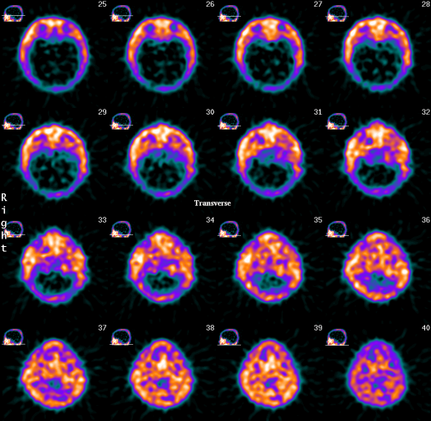
Brain Death
- Patient 1
No intracranial blood flow or radiotracer uptake in all regions of the brain
Expected extra cranial scalp, skull base, and soft tissue activity which is increased in brain death (shunting of blood)

Slide 7
Brain Death - Patient 2

Slide 8
Brain Death – Patient 3

Slide 9
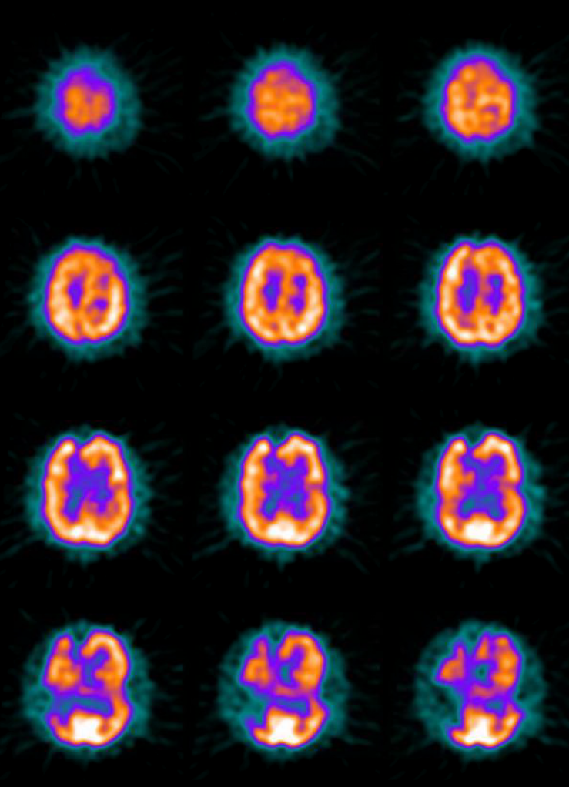
Brain Injury
Patient 1
There are multiple scattered focal perfusion defects within the brain (but there is cerebral perfusion)

Slide 10
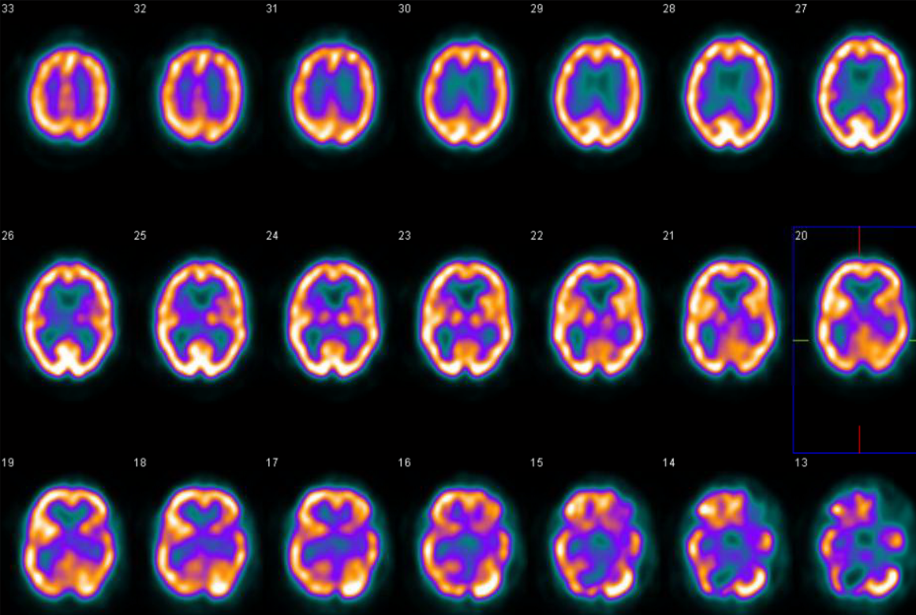
Brain Injury -Patient 2 Focal perfusion defect in the right cerebellar hemisphere

Slide 11
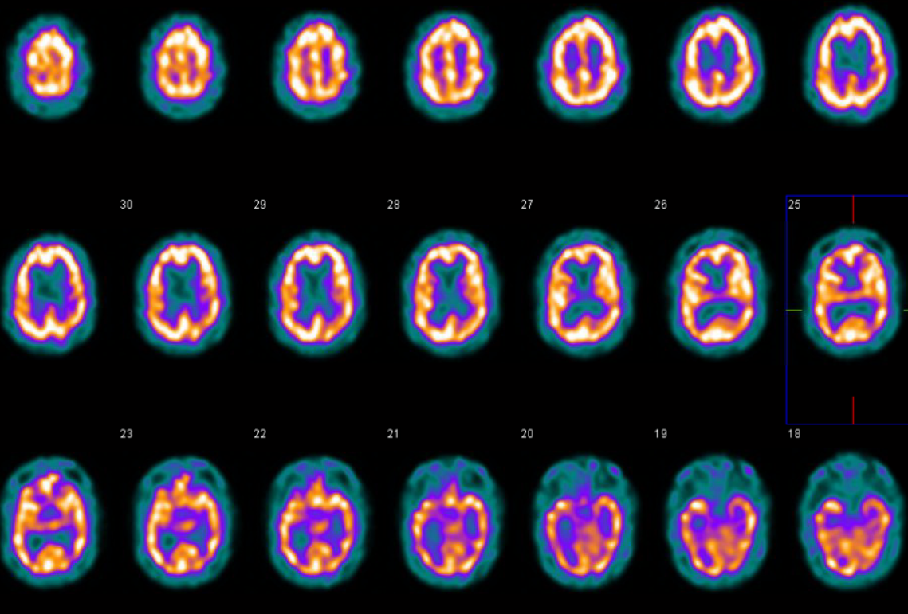
“Normal” Symmetric cerebral perfusion with no focal defects

Slide 12
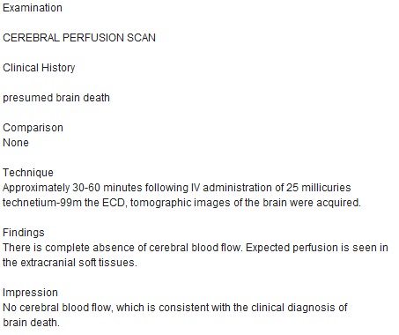
Sample Brain Death Dictation

Slide 13
References
Conrad GR et al: Scintigraphy as a confirmatory test of brain death. Semin Nucl Med. 33(4):312-23, 2003
Donohoe KJ et al: SNM practice guideline for brain death scintigraphy 2.0. J Nucl Med. 40(3):198-203, 2012
StatDx®

