Slide 1
Nih public access policy
Stephanie Morgan
Senior Grants Associate
Office of Sponsored Projects Dartmouth College

Slide 2
AGENDA
Provide High Level Overview of NIH Public Access Compliance as it relates to INBRE
Highlight Action Steps for Monitoring & Maintaining Compliance
Provide Resource Links & Helpful Illustrations to Clarify Compliance Process
Discuss Common Causes of Noncompliance & How to Avoid Them

Slide 3
Did you know it’s a law?
The NIH Public Access Policy implements Division F Section 217 of PL111-8 (Omnibus Appropriations Act, 2009). The law states:
The Director of the National Institutes of Health ("NIH") shall require… that all investigators funded by the NIH submit… to the National Library of Medicine's PubMed Central an electronic version of their final, peer-reviewed manuscripts upon acceptance for publication, to be made publicly available no later than 12 months after the official date of publication: Provided, that the NIH shall implement the public access policy in a manner consistent with copyright law.

Slide 4
PUBLIC ACCESS POLICY
Peer-reviewed publications resulting from INBRE-funded research must be deposited in PubMed Central
NIH requires publications associated with a grant be reported in the RPPR
INBRE Program Officer noted a lack of publications during the RPPR review
Required to tell NIH the publications that have resulted from their funding.
Once you understand the systems involved it will become routine to submit your articles.

Slide 5
Systems Involved in Public Access Compliance
eRA Commons
Link to My NCBI
Research Progress Performance Report (RPPR)
My NCBI
My Bibliography
NIHMS (NIH Manuscript Submission)
System to submit peer-reviewed, accepted manuscripts to PubMed Central (PMC)
PMC (PubMed Central)
NLM free, full-text archive of biomedical & life sciences journals
ACTION ITEMS:
Sign into My NCBI using your Commons credentials
Link your Commons account to your My NCBI account
Choose your NIHMS log in method (e.g., Commons) and use that method each time you log in

Slide 6
Public Access
Journal articles are freely available
Progress Reports (RPPR)
How NIH assesses compliance
Responsibility of the Author
Responsibility of the INBRE PI
NIHMS
PMC
My NCBI
eRA Commons
NIH Manuscript Submission System
Four Methods: A, B, C, and D
PubMed Central
Publications not compliant until PMCID assigned
My Bibliography
Research Performance Progress Report (RPPR)

Slide 7
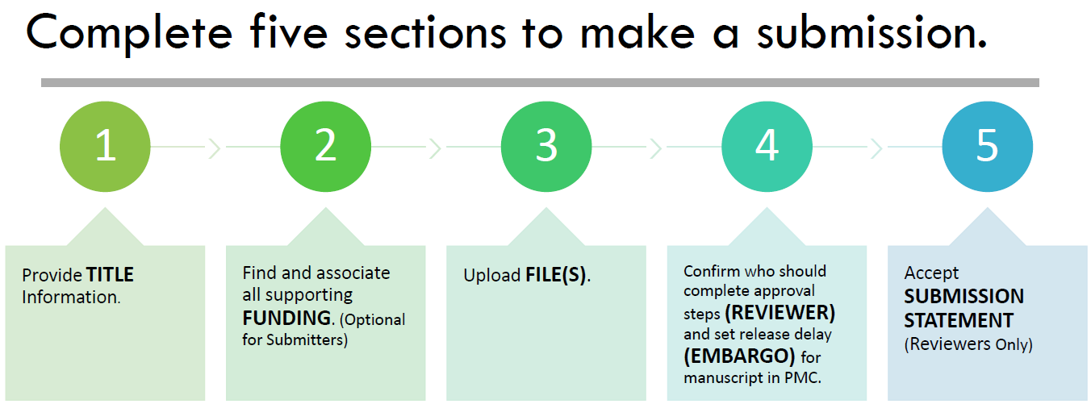
Information Needed for NIHMS

Slide 8
Who can Submit?
Submitter
A manuscript can be submitted to NIHMS by the author, the PI, the publisher, or other third party (e.g., assistant, librarian). In the case of third-party submissions, the Submitter must assign an author or PI to review the record. If the Submitter is the author or PI, he or she may also serve as the Reviewer.

Slide 9
SUBMISSION STEPS
Step 1: Author submits manuscript (PI, Publisher, or Third Party can also submit).
Step 2: The Author reviews, confirms or adds associated funding, and rejects or approves processing in NIHMS.
Step 3: NIHMS staff reviews and complete submissions are converted to archival XML (PMC-ready documents).
Step 4: Author reviews the PMC-ready documents to request corrections or approves the. Final Approval is required.
Step 5: PMCID is assigned, manuscript is matched to a PubMed record with complete citation information.
Step 6: The manuscript is made available in PMC following the publisher-required embargo period (if applicable).
Deposit Files
Initial Approval
NIHMS Conversion
Final Approval
PMCID Assigned
Available in PMC

Slide 10
NIHMS TUTORIAL LINKS
Log in:
https://trace.ncbi.nlm.nih.gov/core/assets/nihms4/help/NIHMS_Login_Tutorial.pdf
Deposit Files:
https://trace.ncbi.nlm.nih.gov/core/assets/nihms4/help/NIHMS_Submission_Tutorial.pdf
Initial Approval:
https://trace.ncbi.nlm.nih.gov/core/assets/nihms4/help/NIHMS_Initial_Approval_Tutorial.pdf
Final Approval:
https://trace.ncbi.nlm.nih.gov/core/assets/nihms4/help/NIHMS_Final_Approval_Tutorial.pdf
Deposit & Initial Approval Video:
https://youtu.be/UwIrhRTj8-M
PDF tutorial documents that include step by step instructions with screenshots
YouTube video displaying Key Moment sections to find the instructions you need quickly (6 min)

Slide 11
NIHMS TUTORIAL LINKS
Publication Submission Methods
There are four methods to ensure that an applicable paper is submitted toPubMedCentral (PMC) in compliance with the NIH Public Access Policy. Authors may use whichever method is most appropriate for them and consistent with their publishing agreement.
Overview of Submission Methods: https://publicaccess.nih.gov/submit_process.htm#Overview
Submission Method Wizard: https://publicaccess.nih.gov/submit_process_journals.htm
A. Journal automatically posts to PMC
B. Author needs to make submission arrangements with publisher
C. Author submits
D. Publisher submits to NIHMS

Slide 12
A Word About Identifiers
PubMed ID is not the same as a PubMed Central ID (PMCID)
Only PMCID is Public Access Policy compliant (add to citations when assigned)
A PMCID is assigned to an NIHMS submission when both occur:
1. The Final Approval step is complete.
2. Article matched to a PubMed record for one of the following:
a. final print publication date or
b. electronic publication date for electronic-only journal only or
c. an electronic publication date for a journal in which PubMed has not received the final print publication date within 6 months of the electronic publication date.

Slide 13
YOUR FRIEND ‘MY NCBI’
My Bibliography allows you to track your publication compliance
SciENcv can be used to create your NIH biosketch in the correct format
SciENcv will be required for NIH Other Support

Slide 14
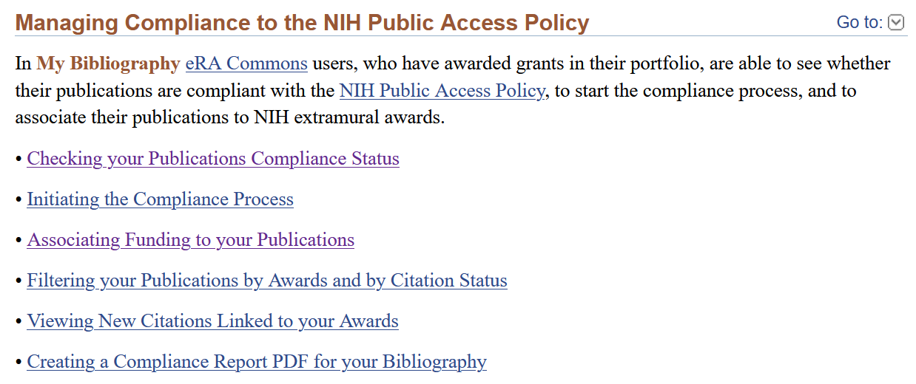
Create ‘My Bibliography’ in ‘My NCBI’
Grant PIs must use My Bibliography to manage their publications list in eRA Commons.
Please visit the My NCBI Help page or My Bibliography FAQ for more information
Reference tool to save your citations (journal articles, books/chapters, patents, presentations, & meetings) directly from PubMed or, if not found there, to manually enter them using My Bibliography templates.
My Bibliography provides a centralized place where citations are easily accessed, exported as a file, and made public to share with others.
My Bibliography allows you to add delegates to manage your publications

Slide 15
Monitoring Publication Compliance in My Bibliography

Slide 16
COMMON CAUSES OF NONCOMPLIANCE
Late NIHMS Submission
Missing Grant Link
My Bibliography
NIHMS Approvals
2-3 week process
Noncompliant status needs to be in RPPR
Initial and Final
Monitor Status in My NCBI
Needed for RPPR integration
Can be entered via NIHMS or My Bibliography
Publication Status not Monitored in My NCBI
Method B has 3 mo requirement

Slide 17
questions
That was a lot of information!

Slide 18
Compliance Disclosures

Slide 19
Financial Conflict of Interest
Researchers and their respective institutions are responsible for following a Financial Conflict of Interest policy that is compliant with NIH regulations to receive funding
A financial conflict of interest exists when the institution's designated official(s) reasonably determines that an investigator's significant financial interest (SFI) could directly and significantly affect the design, conduct, or reporting of the NIH-funded research.
High level guidance can be found at: https://grants.nih.gov/grants/policy/coi/index.htm
Details of required information are contained in HHS regulation 42 CFR Part 50 Subpart F, Promoting Objectivity in Research (FCOI regulation).

Slide 20
What compliance looks like
Review your institutional policy on FCOI for specific details
Examples include:
Annual COI disclosure
Project-specific disclosure
Financial information of a certain threshold must be disclosed
If your institution receives NIH funds, then they will have a policy
Please remember to comply with it

Slide 21
Research Support & Foreign Transparency
NIH identifying foreign authors of RPPR publications
Requiring statement if funds were spent in a foreign country
High level of scrutiny on Grants that do not allow foreign components
All Federal Agencies must comply with NSPM-33
Undue foreign influence
NIH Biosketches & Other Support leveraged for this purpose
Disclose all foreign sources of research support, even if unpaid
Foreign appointments are listed on Biosketches
Foreign employment contracts are appended to Other Support documents

Slide 22
Thank you

