Slide 1
Social Determinants of Health at LRHC
Maureen B. Boardman, MSN, FNP-C, FAANP
Director of Clinical Quality Little Rivers Health Care

Slide 2
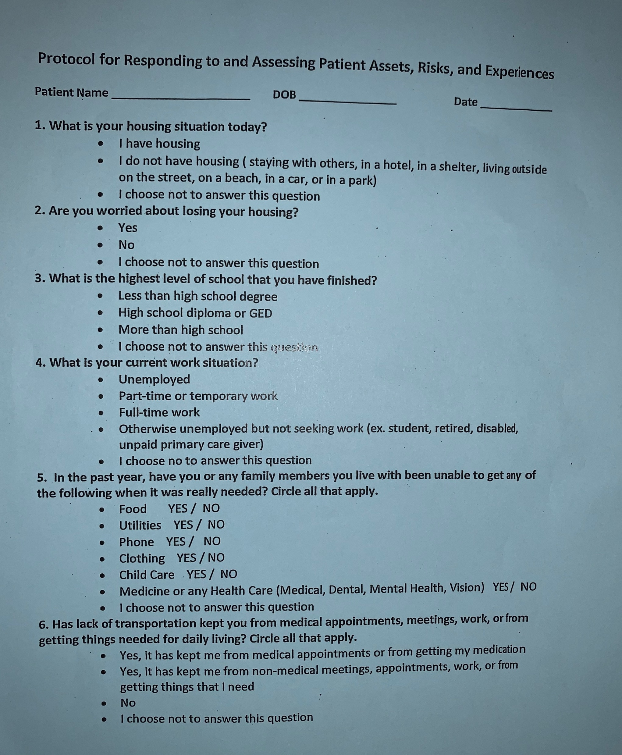
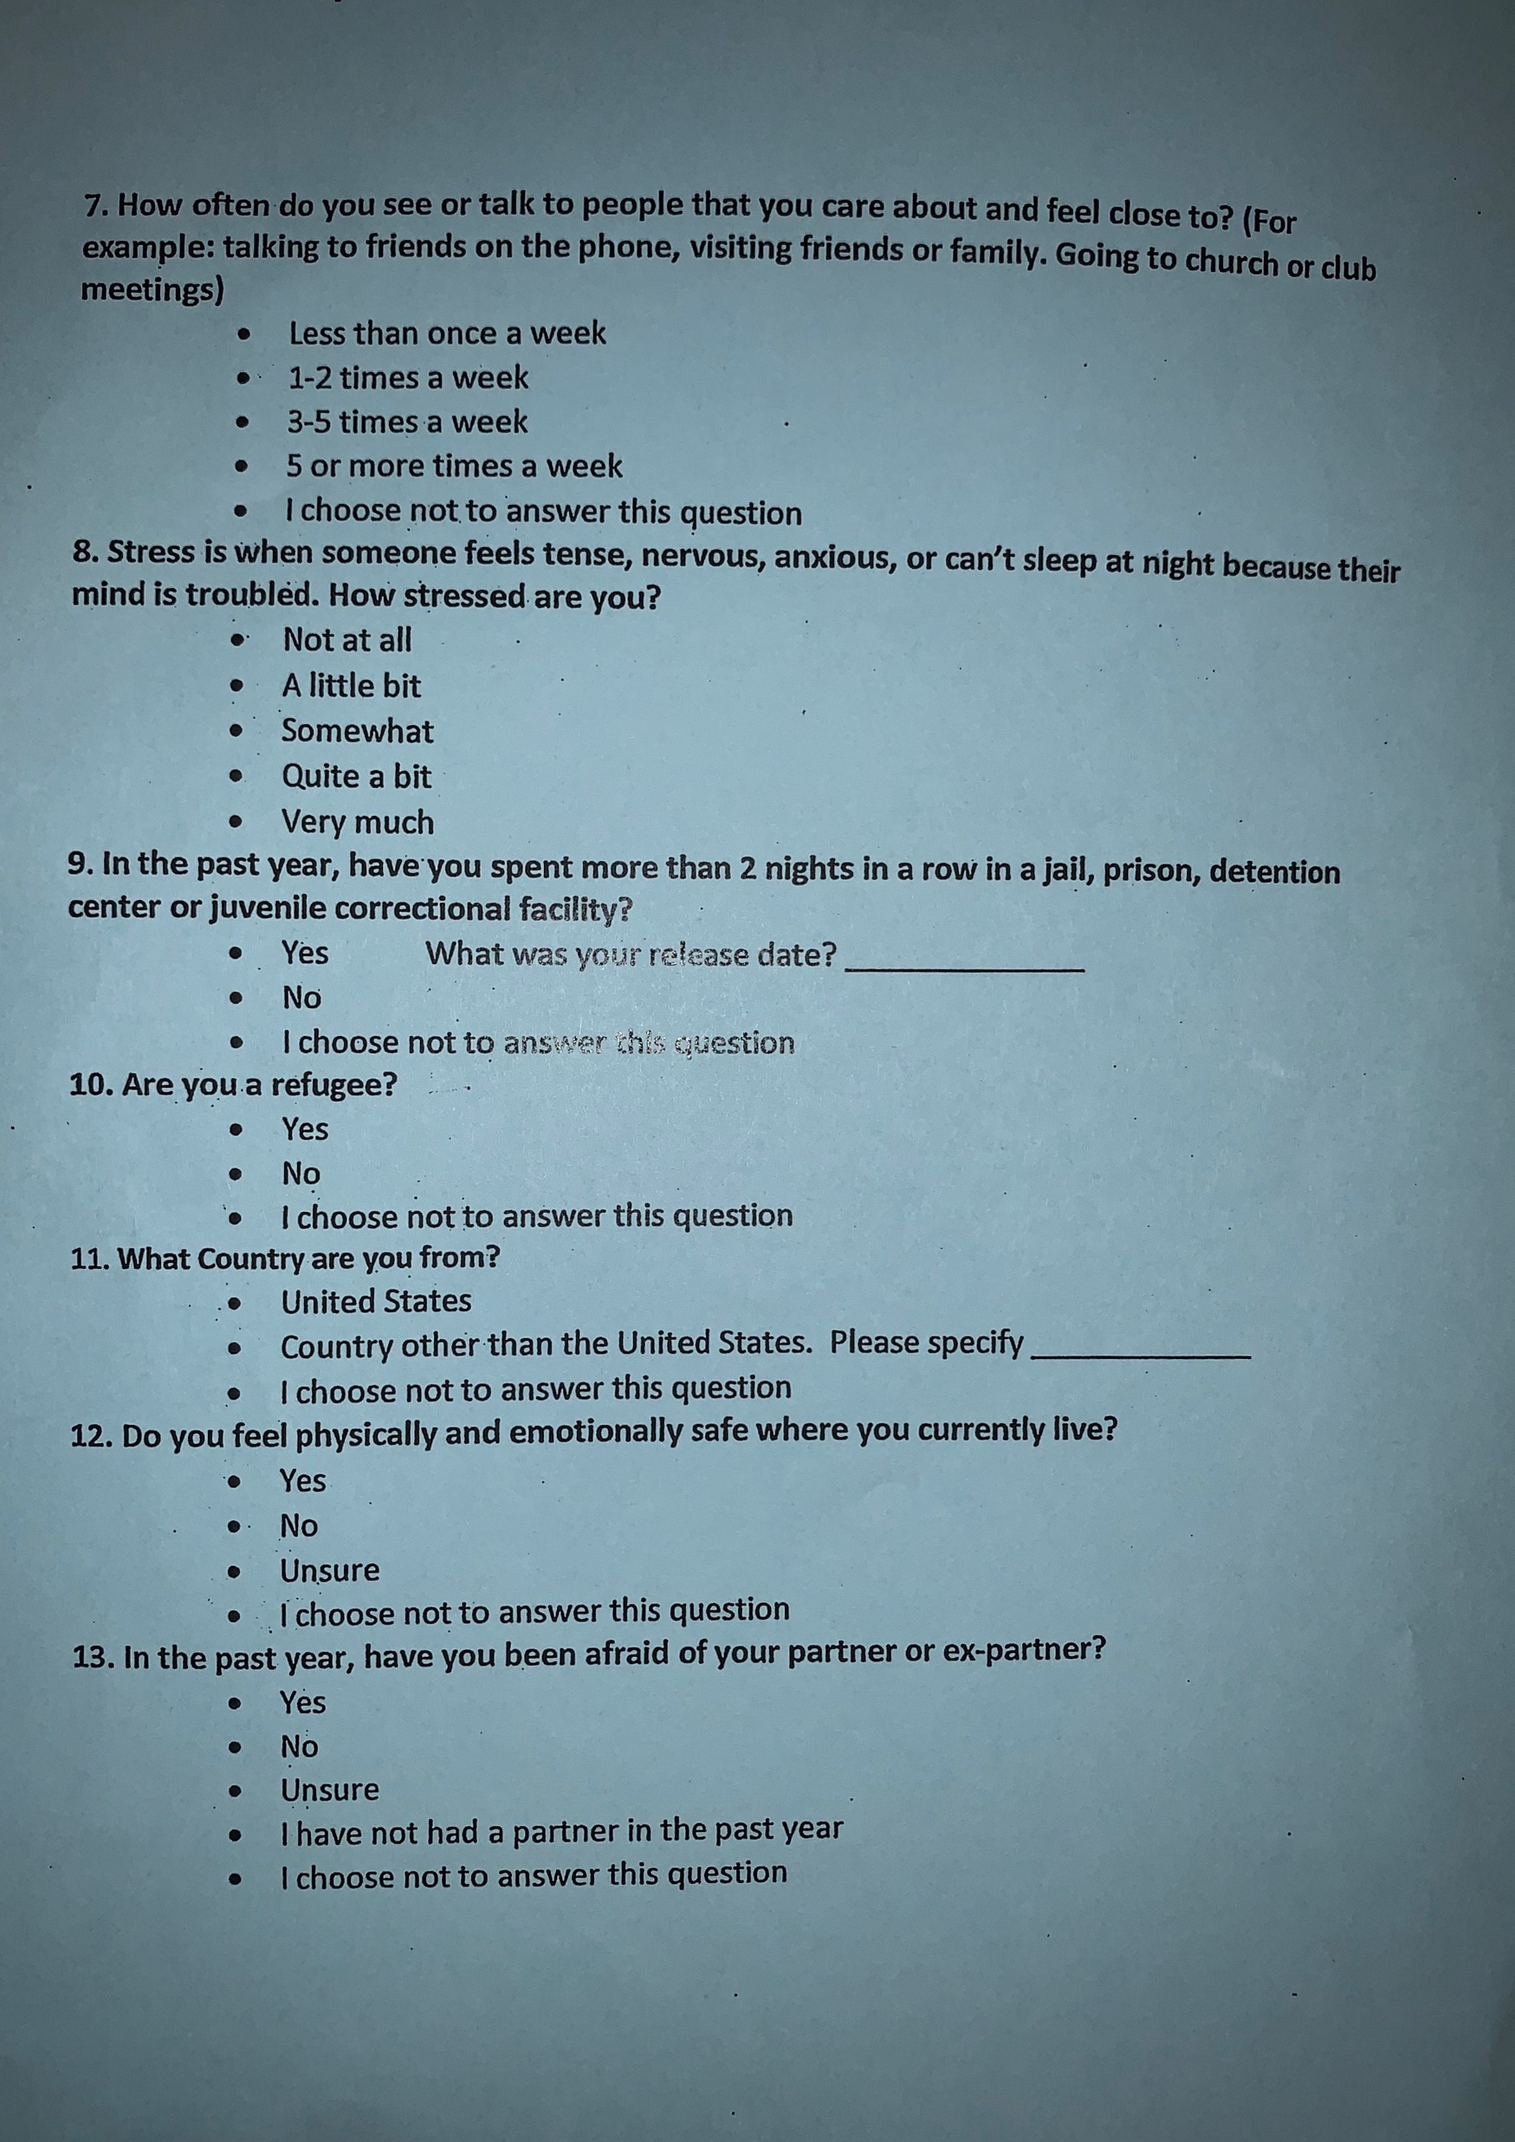
Protocol for Responding to and Assessing Patient Assets, Risks and Experiences

Slide 3
Hunger as a Vital Sign
Within the past 12 months, we worried whether our food would run out before we got money to buy more.
Within the past 12 months, the food we bought just didn’t last and we didn’t have money to get more.

Slide 4
Upper Valley Resource Assistance Guide
Printed on Waterproof paper
Emergency Crisis Lines
Police and Fire Department Numbers
Community Resources & Services
Food shelves and Kitchens
Farmer’s Markets
Grocery Stores and Supermarkets
Stores with Limited Food Selection

Slide 5
East Orange County Food Resource Guide

Slide 6
Grocery Stores and Supermarkets

Slide 7
WIC, Community Gardens and Cooking Classes

Slide 8
Community Meals, Summer Meals and Senior Meals

Slide 9
3 Squares Vermont for Vermonters under 60

Slide 10
3 Squares Vermont for Vermonters 60+

Slide 11
Public Transportation

Slide 12
The Growing Peace Project

Slide 13
The Growing Peace Project
A peacemaking, social justice and youth activism initiative that is a national program, brings together kids from different communities across the US. Throughout the school year they learn about each other’s lives and cultures while collaborating on social issues they are passionate about.
Each partnership year culminates in a 4-day summer youth activism retreat in Tompsham Vermont
They have developed local programs that directly serve Vermont neighbors in Need. With a free food teaching garden and orchard. Teaching family cooking classes and support gleaning and plant a row initiative
Gave away 200 lbs of vegetables in one day in the fall at Little Rivers Bradford Clinic

Slide 14
Willing Hands

