Slide 1
Review of Year 1 Pathology course
Course occurs in the Spring term of Year 1
Course Directors – Rand Swenson, Wendy Wells
Course has 47 curricular hours
Course was last reviewed in October 2015
Date of this review: November 2017
Review scheduled for presentation to MEC: December 2017

Slide 2
Action Plan from Prior Review
Course Objectives
Ms. Gagnon and I will be reviewing the course objectives over the next month. Our goal is to reduce them by one third and where appropriate combine them. The list of course objectives on Canvas represents an older list of objectives that was transposed to Canvas evidently prior to our correcting the typos, etc., in Ilios. We will make the corrections and post the revised list of objectives on Canvas before the end of this year. Additionally, course objectives that are not being assessed will either be removed or revised.
[Course objectives were reduced from 36 to 28, however the number is still too high and some objectives are vague or seem more appropriate for session objectives, e.g. “Diagram the coagulation cascade and discuss clotting and bleeding disorders.”]

Slide 3
Action Plan from Prior Review
Redundancy and Coordination with Microbiology
I have contacted all four of these course directors with a request that we meet in the next few weeks to review potential areas of unnecessary repetition. While some repetition on certain topics is needed, there may be areas where it is unintended and nor important. We will identify these areas. It may be necessary to get the input of the MEC to determine which course is preferable for the presentation of the overlapping material. Once this has been resolved, adjustments will be made to our General Pathology course for the spring of 2016.
This parallel material [with micro course] will be reviewed with Drs. Sundstrom and Schwartzman. The position of “Infectious Diseases” in the flow of the Pathology curriculum is logical as the concepts they elucidate require what has been previously taught in prior sections. It may be possible to modify schedules between the two courses so there is more synergy. This will have to be examined and alterations made, if possible.
[Redundancy was dealt with in part by eliminating course hours – a reduction from 63 to 47]

Slide 4
Action Plan from Prior Review
Lecture Hours
We will reduce the number of lectures to get under the 50% lecture content for the 2016 iteration of the course. This will be done in two ways: elimination of certain lectures and changing the mechanism for teaching the material. This will have to be planned and the schedules modified in December 2015 and January 2016. To do this in a thoughtful manner, we will have to know where redundant material is being eliminated, where unnecessary material can be eliminated, and what residual material lends itself to other instructional formats. It will take time to achieve this restructuring.
[Course directorship changed and this goal was not fulfilled; current percentage of lectures is 62%, prior review it was 60.2%]

Slide 5
Action Plan from Prior Review
Small groups are perceived as “mini lectures”
As was discussed at the MEC meeting reviewing General Pathology, we believe these small group sessions are important. It lets us present complex and fundamental concepts and the vocabulary of pathophysiology in an interactive manner. These are not intended to be lectures and they are not viewed as lectures by many students. This point will be reviewed with the small group leaders to ensure the format is not one that could be construed as lectures. The small group sessions attempt to get interaction from the students. We will insert more questions requiring student response and exercises requiring the students to employ and demonstrate their understanding of the topics being discussed. These changes will be incorporated in the course in spring 2016.
[Small groups were removed from the course in AY 16-17]

Slide 6
Action Plan from Prior Review
Assessment questions have negative stems
Our test questions are being reviewed in light of the transition of the individual questions into the ExamSoft. During this transferal, all questions with negative stems will be reworked. All of our exam questions will be in USMLE format, if a multiple choice question. Short answer and fill in the blank type questions will be retained. Our “Slide Quiz” questions will remain in the short answer format. These latter questions are keyed to specific histological images to which they are linked.
[Negative stems were removed from the assessment questions]

Slide 7
Action Plan from Prior Review
Remove offensive content in the course or provide advance warning
The lectures with purportedly “offensive” or disturbing images have been noted by very few students. One of these lectures is Forensic Pathology taught by the State’s Chief Medical Examiner. It is likely these lectures will be eliminated from the course. It is ironic that these lectures are the ones which are most highly rated by students – in their numerical scores and written comments – year after year. Yet, it is not a required part of the medical student curriculum.
The problem of “offensive remarks”, and what constitute such, is highly complex. Issues of intent, context, appropriateness, and pedagogical importance all must be assessed when determining is something is offensive. As course director I do propose to deal with it on a case-by-case basis. If there are disagreements, then the issue would be discussed with Senior Associate Dean for Education as well.
[The State’s Chief Medical Examiner will still provide a lecture but disturbing images have been removed from the lecture. Other perceived offensive remarks have been addressed at the highest level]

Slide 8
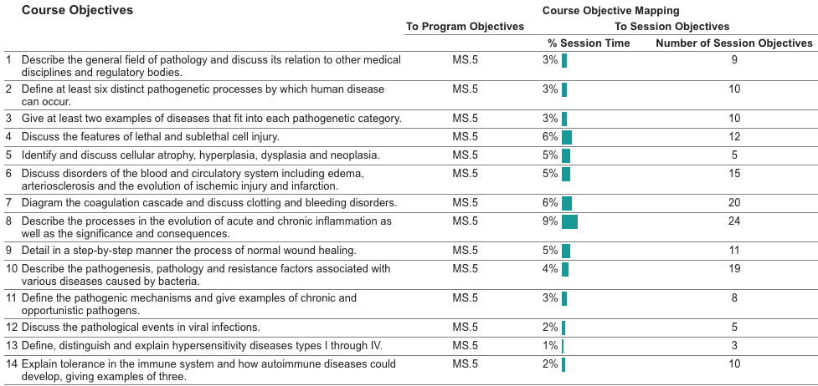
Course Objectives

Slide 9
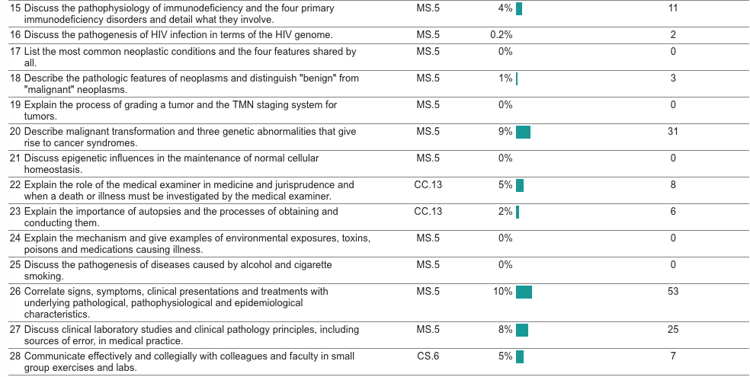
Course Objectives (cont.)

Slide 10
Course Objectives – Comments
There are 28 Course Objectives for a 13 week course (too many); items are overly-detailed. For example, the following three objectives could be combined into an single objective related to pathology of infectious diseases:
10. Describe the pathogenesis, pathology and resistance factors associated with various diseases caused by bacteria.
11. Define the pathogenic mechanisms and give examples of chronic and opportunistic pathogens.
12. Discuss the pathological events in viral infections.

Slide 11
Course Objectives – Comments
Course Objectives #17, 19, 21, 24, & 25 are not currently mapped to any session objectives
25 of 28 Course Objectives are mapped to Geisel Competency MS.5, but none are mapped to MS.2 (most basic science material typically maps to MS.2)
MS.2. Apply core biomedical and social science knowledge to understand and manage human health and disease.
MS.5. Integrate medical science knowledge and the skills of critical thinking (observation, evaluation, inference, interpretation, and judgment) into sound clinical reasoning.

Slide 12
Format of Course & Session Objectives
Course objectives are provided in the syllabus
Course objectives are written in the correct format, however some verbs (e.g. “discuss”) are difficult to assess
Session objectives are provided in the course materials
Some Canvas sessions have different session objectives than what are displayed in Oasis (this should not be an issue moving forward as session objectives in Canvas are pulled from Oasis and then locked)
Session objectives are written in the correct format
Again, some discrepancies between Canvas & Oasis but should not be an issue moving forward

Slide 13
Issues of Redundancy
There is substantial overlap with Immunology/Virology/Microbiology for some objectives (including 8-16). In the prior year, all material related to Objective 13 was removed (now covered entirely in MICR111/Immunology). The Course Director should coordinate with the CD for Imm/Vir/Mic to fully assess the overlap and redundancy for objectives 8-12 and 14-16, and to plan content accordingly (with basic immunology/ID biology in Imm/Vir/Micr courses that appropriately preview the content in Path, which is related to host disease processes).

Slide 14
Health and Values Goals
Ethics – “Identify key concepts in health care ethics and demonstrate an ability to recognize ethical issues arising in patient care and population health and to think critically and systematically in applying an ethical analysis”
Cultural Awareness – “Demonstrate an understanding and skill in managing patient care of people of diverse cultures, social, economic standing and belief systems”
Health Equity – “Identify the root causes and approaches for addressing health disparities locally and globally”
Resilience – Demonstrate knowledge of skills and practices to prevent and address stress and maintain resilience in caring for patients and oneself
Compassion and Empathy – “Demonstrate abilities to understand each patient’s experience of illness, adapt scientifically appropriate care to conform to that patient’s needs, and communicate in terms that each patient can understand”
There also are synergies to health law, communication skills, professionalism (as LCME requires).

Slide 15
Health and Values Content
What Health and Values Program material (healthcare ethics, cultural awareness, health equity, resilience, compassionate care) is presented in the course?
Privacy and confidentiality of patient records
Ethics of specimen integrity
Consenting for autopsies
Are the Health and Values topics noted in the course and session objectives?
After discussions with Bill Nelson, specific objectives have been created
The student rep felt that the material is there, but just not explicit in objectives.

Slide 16
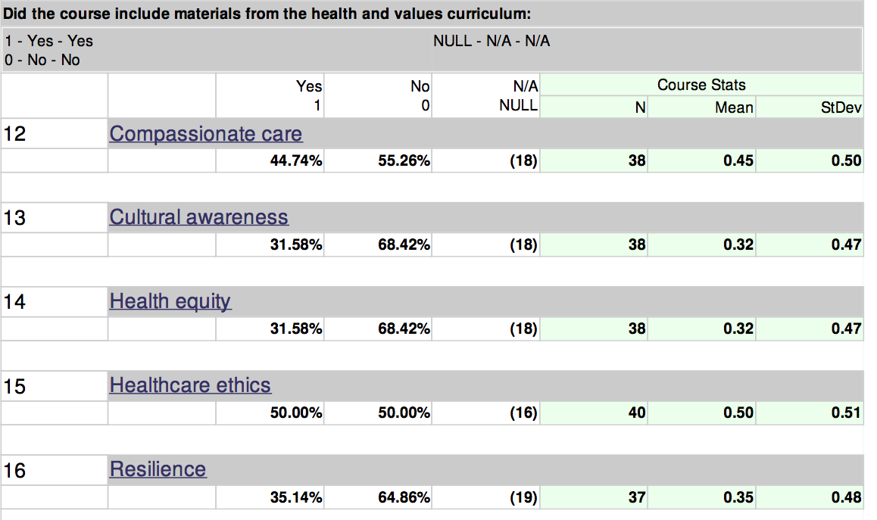
Health and Values Content
What do the student evaluations indicate regarding Health and Values teaching?

Slide 17
Health and Values Content
Student comments:
“A PBL could have been useful in better integrating these values.”
“It's pathology: slides, histology and molecular biology and wrapped in one. Pretty hard to have long ethical discussions at the basic science level we're seeing here (and hasn't been covered in another class or setting already).”
“…the instructors were excellent in incorporating ethical and clinical topics into their lectures. For instance, the CPC presented by Dr. Tsongalis touched on issues related to privacy and confidentiality, whereas the lecture on lab tests by Dr. Cervinski highlighted issues pertaining to clinical judgment and reliance on lab tests.”

Slide 18
Nutrition Objectives
Medical Science
Describe core nutrition science concepts, such as nutritional biochemistry and metabolism, digestion, endocrinology, and adverse effects of malnutrition on human health.
Explain the links between nutrition science and other sciences, including those of the environment, exercise, toxicology, and pharmacology.
Apply core nutrition science knowledge to understand and manage human health and disease through the lifespan.
Clinical Care
Perform a nutrition assessment and accurately measure anthropometrics.
Perform a complete nutritional exam to assess for presence of malnutrition.
Interpret, develop, and implement a nutrition plan for treatment, including nutritional additions or restrictions, culinary skill development, artificial nutrition support, and supplementation.
Population Health
Explain the impact of nutrition on individual and population health and disease.
Assess the impact of social, environmental, behavioral, economic, cultural, and personal factors on the nutritional health of individuals, and the incidence and burden of disease in populations.
Explain and exemplify the physician’s role for promoting nutrition in public health.
Notes:
Description of the Nutrition curriculum.

Slide 19
Communication Skills
Demonstrate empathy for individuals’ concerns, and be respectful of others’ perspectives and personal, cultural, and religious dietary restrictions and beliefs, and communicate nutrition advice respectfully and without judgment.
Promote positive behavioral change through nutrition-specific motivational interviewing and cognitive behavioral therapy.
Translate nutrition science concepts in to useful information to educate patients, families, peers, and others.
Personal, Professional, and Leadership Development
Engage in lifelong learning to improve one’s performance in the application of nutrition science.
Apply nutrition science and culinary competency to enhance resiliency and physician self-care.
Advocate for environments that promote healthy nutritional lifestyles in the community, while removing any existing barriers.
Evaluation and Improvement
Identify and utilize healthcare and community resources to provide nutrition care and improve patient outcomes and patient satisfaction.
Identify credible, evidence-based sources of nutrition information and apply knowledge gained from the literature to clinical care, teaching, research, and population health.
Collaboration and Teamwork
Recognize and capitalize on different roles and strengths of team members, including the clinical dietitian, to develop and address shared goals, and foster a working relationship with all team members built on mutual respect and trust.
Demonstrate the ability to share and allocate responsibilities among team members.
Notes:
Description of the Nutrition curriculum.

Slide 20
Nutrition Content
What nutrition content is presented in the course?
N/A [Nutrition thread director didn’t feel that content was relevant for this course]
Are nutrition topics noted in the course and session objectives?
N/A

Slide 21
Summary regarding Objectives
There are too many course objectives for the course and some use verbs that are difficult to assess; some objectives do not have session objectives that map to them
Session objectives on Canvas do not match with Oasis
Redundancy exists between the Pathology Course and the Immunology/Virology/Microbiology courses
Health and Values content is present in the course but not explicit in the objectives

Slide 22
Course Learning Opportunities
Lecture 29 hrs. (62%)
Laboratory 7.5 hrs. (16%)
Case-Based Instruction/Learning 6 hrs. (13%)
Assessment 4.5 hrs. (9%)

Slide 23
Course Learning Opportunities
The percentage of lectures in the prior review was 60.2%, and it was 62% for AY 16-17. The increase was partially due to a reduction in lab hours, however the percentage is still higher than MEC guidelines
Format and quality of lectures varied significantly – substantial number of lecturers (14) led to a lack of awareness about what content other faculty were teaching
Small group sessions, which were previously described as not effective, were eliminated
Lab sessions were well-received by students; students enjoyed opportunities to interact with faculty in smaller groups

Slide 24
Summary regarding Pedagogy
The percentage of traditional lectures surpasses Geisel’s recommended target of 40-50% of contact hours
Coordination among faculty is lacking with regard to delivering course content
Lab exercises are a valuable portion of the course that contribute to student learning

Slide 25
Assessment
Written Quizzes: 3 (40% of final grade)
Lowest quiz weighted half as much as the other two
Lab: 20% of final grade
prelab “readiness” quizzes and in-lab exercises both contribute to grade
Final Exam: 40% of final grade
According to a statement in the syllabus, attendance and participating factor in to the final grade: “A grade of PASS will be submitted to the registrar if attendance and participation are adequate and the final numerical grade ≥70%. A grade of FAIL will be submitted to the registrar if attendance or participation is inadequate or the final numerical grade is <70%.”

Slide 26
Assessment
Student comments about the assessments (see slide 34) indicate that the content on assessments did not match the content covered in the course
It is not clear how attendance and participation are assessed or applied with regard to passing the course (in other words, how do students know they have met the criteria to pass?)

Slide 27
Assessment for Course Objectives
Objective #1 is not likely assessed (“Describe the general field of pathology and discuss its relation to other medical disciplines and regulatory bodies.”), but it is felt to be important by the course faculty
Objectives #2-27 are assessed with quizzes, exams and laboratory exercises
Objective #28 (“Communicate effectively and collegially with colleagues and faculty in small group exercises and labs.”) is assessed by faculty observations during laboratories, however students do not currently receive feedback on this objective

Slide 28
Summary regarding Assessment
Students’ perceptions regarding assessments in the course indicate that the content assessed does not match the content discussed in the course
Most course objectives are assessed by quizzes, exams and laboratory exercises; feedback is not currently provided regarding communication skills
Expectations regarding attendance and participation, a component of the course grade, are not clearly defined in the syllabus

Slide 29
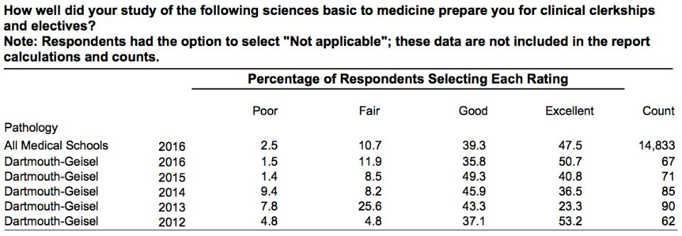
Measures of Quality – Graduation Questionnaire
Data from AAMC Graduation Questionnaire

Slide 30
Measures of Quality – Step I
TRADITIONAL CORE DISCIPLINES | 2014* | 2015* | 2016* | Means 14-16
Biochemistry | 0.22 | 0.03 | -0.04 | 0.07
Biostatistics | 0.08 | 0.29 | N/A | 0.185 (14-15)
Genetics | 0.28 | 0.09 | -0.36 | 0.003
Gross Anatomy/Embryology | 0.14 | 0.16 | -0.12 | 0.06
Histology/Cell Biology | 0.23 | 0.07 | -0.09 | 0.07
Microbiology/Immunology | 0.39 | 0.02 | -0.01 | 0.13
Pathology | 0.20 | 0.12 | -0.10 | 0.07
Pharmacology | 0.12 | -0.02 | 0.0 | 0.03
Physiology | 0.25 | 0.11 | 0.06 | 0.14
*values reported for core disciplines are SD above the US/Can mean for Geisel mean scores

Slide 31
Measures of Quality – Course Evaluation
Measures of Quality – Course Evaluation
Year 1 courses | Overall quality AY 14-15 | Overall quality AY 15-16 | Overall quality AY 16-17
Basic Science of Microbial Disease | 3.94 | 4.10 | 4.73
Biochemical and Genetic Basis of Medicine | 4.34 | 4.40 | 4.54
Cells, Tissues and Organs | 4.07 | 4.06 | 4.21
Human Anatomy and Embryology I | 4.35 | 4.04 | 4.61
Human Anatomy and Embryology II | 4.57 | 4.43 | 4.74
Immunology and Virology | 3.67/3.77 | 3.94/3.83 | 4.70
Metabolic Basis of Disease | 4.35 | 4.48 | 4.25
Neuroscience | 3.59 | 3.32 | 2.93
On Doctoring | 3.74 | 4.10 | 4.07
Pathology | 3.22 | 3.06 | 2.61
Patients and Populations | N/A | 2.77 | 2.79
Physiology-Cardiovascular | 3.23 | 3.41 | 3.88
Physiology-Endocrine | 3.76 | 3.52 | 3.63
Physiology-Renal | 4.19 | 3.63 | 3.46
Physiology-Respiration | 3.34 | 3.41 | 3.80
scale [1=poor; 2=fair; 3=good; 4=very good; 5=excellent]

Slide 32
Measures of Quality – Course Evaluation
scale [1=poor; 2=fair; 3=good; 4=very good; 5=excellent]
 | PATH 121 AY 14-15 (91.2%)* | PATH 121 AY 15-16 (87.2%)* | PATH 121 AY 16-17 (80%)*
Overall satisfaction of course | 3.22 | 3.06 | 2.61
Clarity of learning objectives | 3.21 | 3.10 | 2.58
Organization of the course | 3.18 | 2.89 | 2.15
How well the course introduced me to this discipline | 3.46 | 3.38 | 3.10
Congruence of assessment questions to material emphasized in course | 3.04 | 2.97 | 2.34
*student participation rate on course evaluation

Slide 33
Measures of Quality – Student Comments
Strengths:
Laboratories
“The laboratory exercises were very useful and I felt that I learned the most from these sessions. I appreciated the format of the prelab exercise, readiness test, and lab exercise. The faculty present in lab were very helpful and I learned a lot from discussing questions with them.”
“Lecture time should be reduced to give time for more interactive exercises like the laboratory. Those are the sessions where I learned the most from. Most lectures I ignored because they were too convoluted and instead used outside resources to learn the material.”
Faculty
“We've had a total number 14 lecturers in this course, so it was eye-opening for me to learn what they did in their fields.”
“The review sessions with Dr. Rendi were incredibly helpful as an overview of the information that we were expected to know.”
“I thought the large group instructors were clearly passionate about the material they were teaching and were very engaging.”

Slide 34
Measures of Quality – Student Comments
Suggestions for Improvement:
Course organization
“The course seemed very disorganized, with no clear structure to how the information was presented or ordered.”
“…The learning objectives never matched the material in class. I never knew what to study for.”
“I felt that the course was poorly organized, and each lecture seemed totally separate instead of well integrated.”
Material assessed did not match what was covered in class
“The material on the quizzes did not seem to correlate with class and lab material at all. I often felt as though I was using knowledge from other classes to get by on the quizzes. It seemed strange that the final had absolutely no histology.”
“I enjoyed the material, but always felt like I wasn't studying the right things…Material covered in class did not show up on quizzes. Material that was covered in quizzes was not emphasized in class.”
Class materials
“… I relied heavily on Pathoma to grasp course material.”
“iBook was way too long to read. Needs to be made more concise or interactive (video pre-lab?)”
“The pictures [in the ibook] were too small. I rarely knew what I was looking at. The captions referenced specific portions of the slides with no arrows or indicators of what it was that they were referencing.”
Number of faculty
“Having so many guest lecturers made it extremely difficult for us to understand what the main point of each lecture was. We didn't have any central source to ask or resources to refer to that would help inform us of that.
“The downside of having 14 lecturers for one course was inconsistency in teaching styles and expectations. As a student I found it difficult to gauge how much self-teaching was needed for different lecturers.”

Slide 35
Summary regarding Measures of Quality
Students rate the overall quality of the pathology course in the “fair” to “good” range. In AY 16-17 it was ranked #15 out of 15 courses in year 1.
Students enjoyed the laboratory portion of the course and felt that it contributed to their learning
Improvements were suggested for the organization of the course, the congruency between course content and assessed content, the quality of course materials and the coordination among course faculty with regard to content presented

Slide 36
Recommendations (1)
The course objectives need to be revised and the mapping to Geisel Competencies needs to be updated
The course director should consult with Dr. David Mullins to coordinate the pathology content with the immunology and microbiology content
The course director should consult with Dr. Bill Nelson to discuss the Health and Values content and revise session objectives

Slide 37
Recommendations (2)
The course needs to incorporate more active pedagogies into the course (i.e. reduce the percentage of traditional lectures)
Assessments in the course need to be revised to reflect the content discussed in the course
If attendance and participation contribute to the final grade, expectations should be clarified for students (e.g. is attendance necessary at all sessions or is one absence acceptable?)

Slide 38
Recommendations (3)
The laboratory sessions are the most useful and effective part of the course and should be preserved; students suggest that the laboratory ibook could be streamlined.
Improvements are needed for the organization of the course and the coordination among course faculty with regard to content presented

Slide 39
Action Plan (1)
Appoint dedicated Course Director to update, coordinate and oversee course:
Wendy A. Wells MD
Limit the number of Pathology faculty lecturers:
4 Pathology faculty members will each cover 1 of the 4 major topic blocks, with occasional “guest lecturers”.
Have these 4 faculty introduce other pedagogies:
E.g. flipped classes, CPC, Case-Based sessions, videos
Maintain current Laboratory Session format:
Update some of the clinical cases (digital and light microscopy)
Maintain high Faculty to student ratio

Slide 40
Action Plan (2)
Engage with faculty from other courses to decrease redundancy and improve integration:
Already being coordinated by Course Director
Course Objectives: Revise and coalesce to meet nationally-recognized Pathology competencies*:
Now reduced in number from 28 to 9
Session objectives: Revise and coalesce to meet nationally-recognized Pathology competencies*:
*Based on 2016 published national guidelines by the Association of Pathology Chairs’ Undergraduate Medical Education Committee

Slide 41
Action Plan (3)
Revised Course Objectives:
Reduced in number from 28 to 9
Can now map to more Geisel competencies
Explain the mechanisms of lethal and sub-lethal cell damage and the resultant changes in cell appearance.
Describe the tissue adaptations (i.e., regeneration, renewal, repair, atrophy, hypertrophy, hyperplasia) to injury and pathophysiological stressors.
Describe the pathways and mechanisms of injury produced by radiation, environmental toxins, pharmacologic agents (including drugs of abuse), physical stressors and nutrient deficiency and excess.
Describe pathogenic mechanisms of acute and chronic inflammation, and the resulting pathology at the cellular, tissue, and organism levels.
Explain the mechanisms whereby immune system dysfunction can produce cellular injury, acute and chronic inflammation, autoimmunity, allergic reactions, and susceptibility to infection; how these changes affect organ function and the health of the organism; and how therapeutic intervention can mitigate these effects.
Describe: the pathogenic mechanisms of infectious diseases at the cellular, tissue and organism levels; the resulting pathology at the cellular, tissue, and organism levels; and how this pathology contributes to the clinical manifestations of disease.
Discuss the pathogenic mechanisms resulting in alterations in hemodynamics and shock and the resulting pathology at the cellular, tissue and organism levels. Discuss how this understanding explains clinical manifestations associated with these pathologic changes.
Apply knowledge of the functional consequences of changes in the genome to explain how genetic changes are acquired and can lead to functional alterations in mutated genes, leading to cancer.
Discuss the characteristics of neoplasia in terms of morphologic appearance, classification, biological behavior, and staging.

